Slide 1



2024 Single Cell Workship Colombia: Introduction to Transcriptomic Data Analysis
July 15-19, 2024
Bogota, Colombia

Slide 2
Overview
Summary of Experiments
Sequencing Considerations
Going from raw sequencing files to gene count matrices
CellRanger outputs
Working with counts matrices

Slide 3
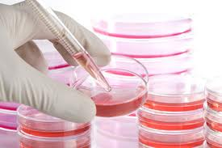
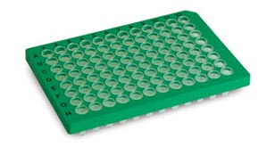
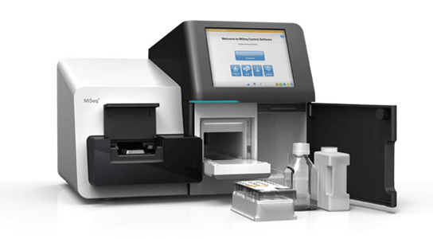
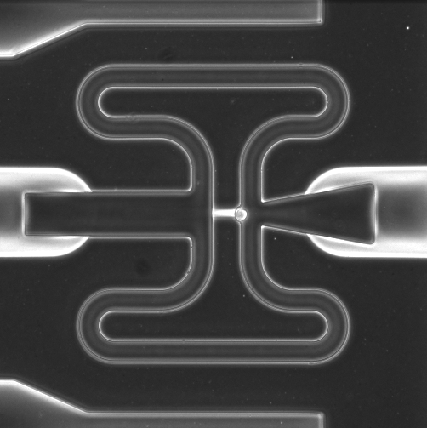
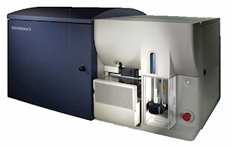
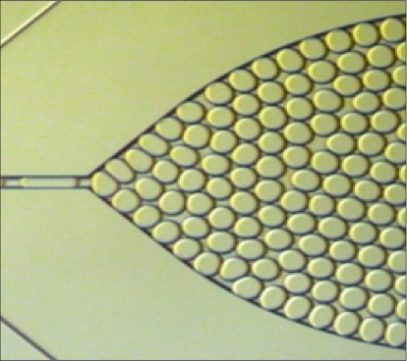
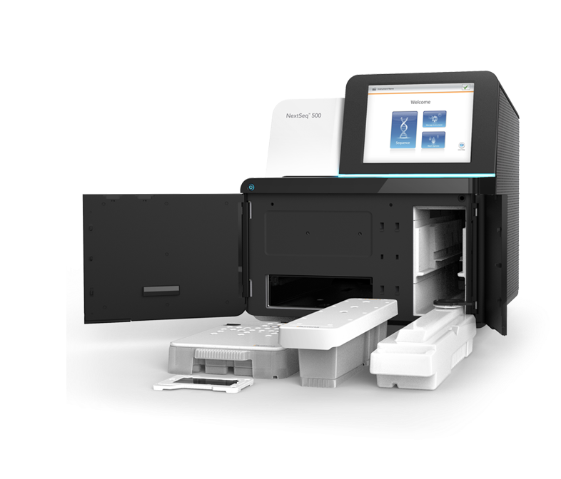

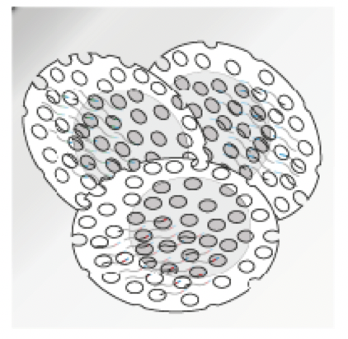
Summary of Single-Cell Expression Profiling Pipeline
Sample preparation
Cell capture
and barcoding
Library prep
Sequencing
MiSeq
FACS
Micro-capture
Droplet
Nanowell
Split/pool
barcoding
PolyA vs random priming
3’/5’ end tagging vs full-length
PCR vs in vitro transcription
…
~20M reads
NextSeq
~ 500M Reads
NovaSeq:
~ 6B Reads
Notes:
This is the general process for many high-throughput single cell RNA sequencing workflows. Beginning with some heterogeneous sample, we remove DNA, protein, and cellular debris in order to isolate mRNA. The mRNA is reverse transcribed and barcoded resulting in a cDNA library. The prepared library is sequenced, yielding millions of reads(or genes) which need to be mapped to a reference genome. The final result is an expression matrix of cells and genes that can be further analyzed. The main point of difference for many of the high-throughput methods is how the barcoded library is generated.
_______________
Before the emergence of scRNA-seq technology, RNA was profiled using Bulk RNA sequencing, which provides an average expression profile of all the cells in the sample. However, single-cell RNA sequencing can break down the spectrum by enabling the dissection of gene expression at the single cell level.The cDNA product is subsequently amplified by PCR. The amplified whole transcriptome product is barcoded and tagmented to prepare a library for sequencing.

Slide 4
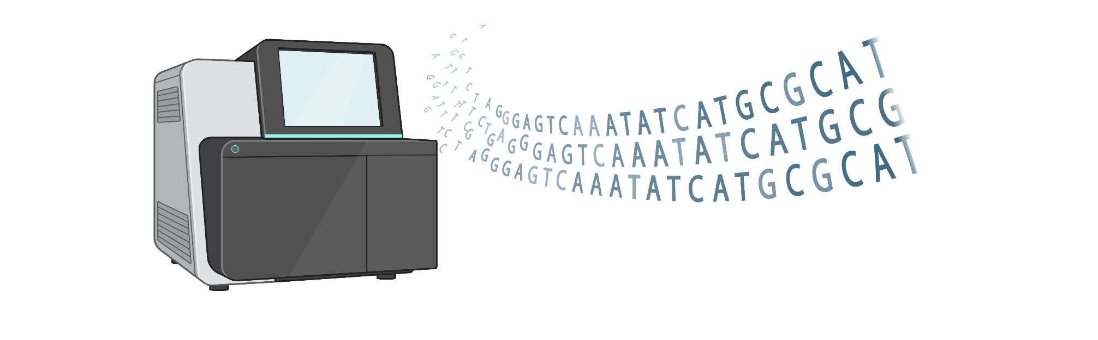
Sequencing Considerations

Slide 5
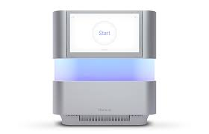
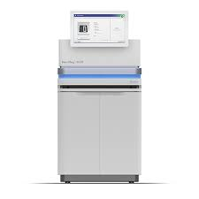

Sequencers
MiSeq
NextSeq 500
NextSeq 2000
NovaSeq
~20M reads
~ 500M Reads
~ 1.2B Reads
~ 6, 10 or 25B Reads
Price
Notes:
10X Sequencing:
VDJ 5,000 read pairs per cell
25M per 10X
GEX 20,000 read pairs per cell
100M per 10X
SS2:

Slide 6
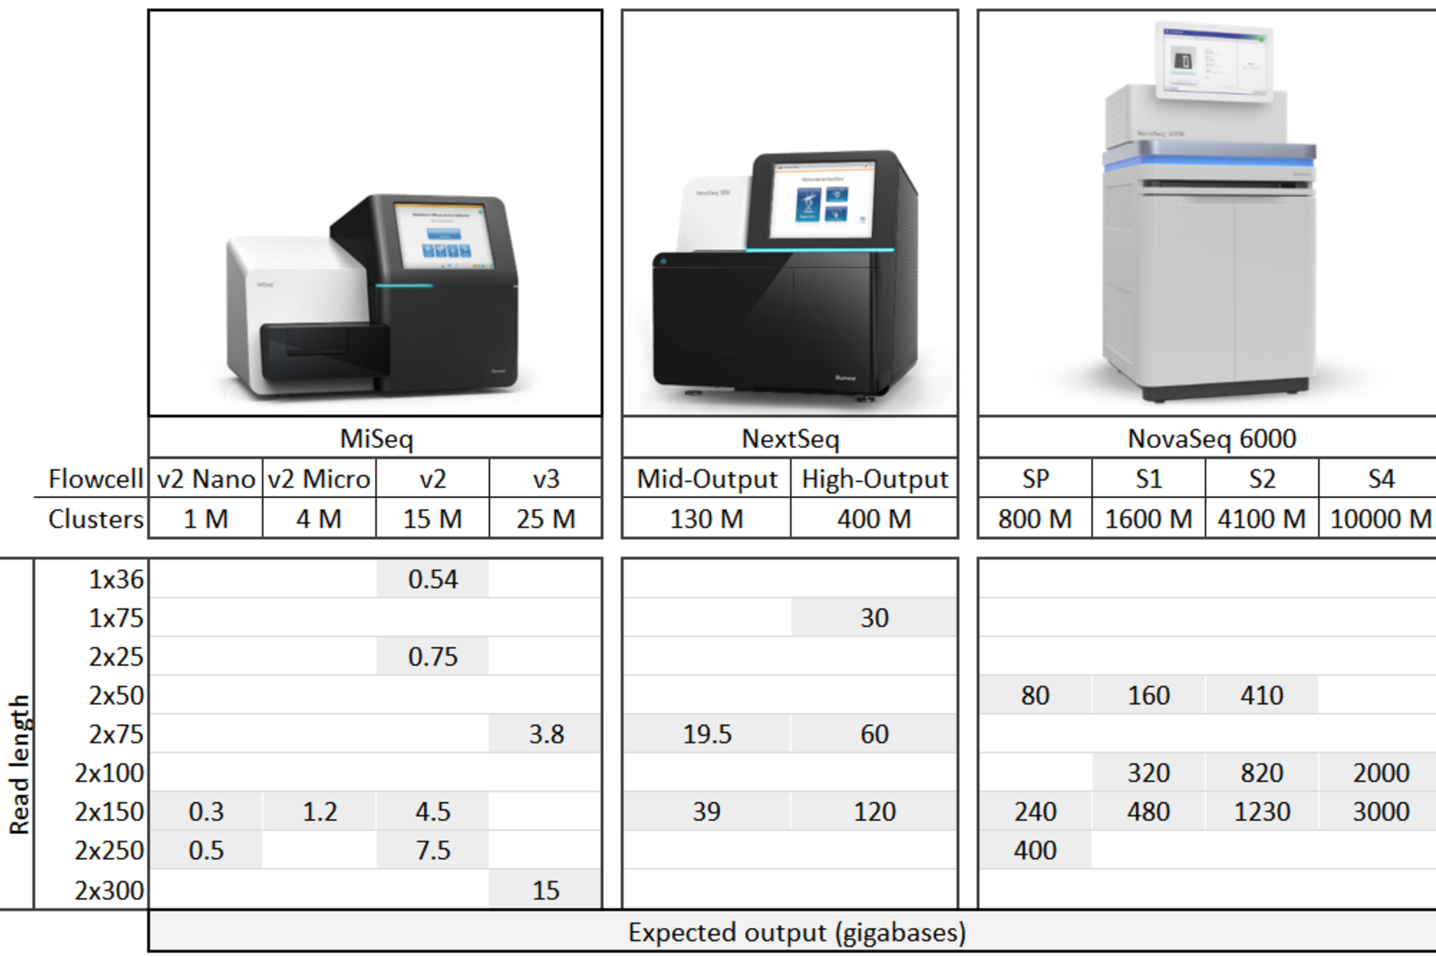
Sequencers
MiSeq
NextSeq 500
NextSeq 2000
NovaSeq
~20M reads
~ 500M Reads
~ 1.2B Reads
~ 6, 10 or 25B Reads

Slide 7
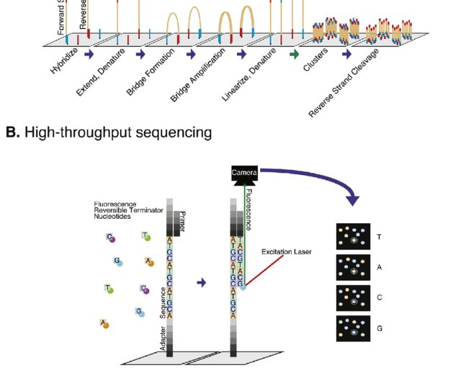
Nonpatterned flow cells can lead to greater data loss due to over-clustering

Slide 8
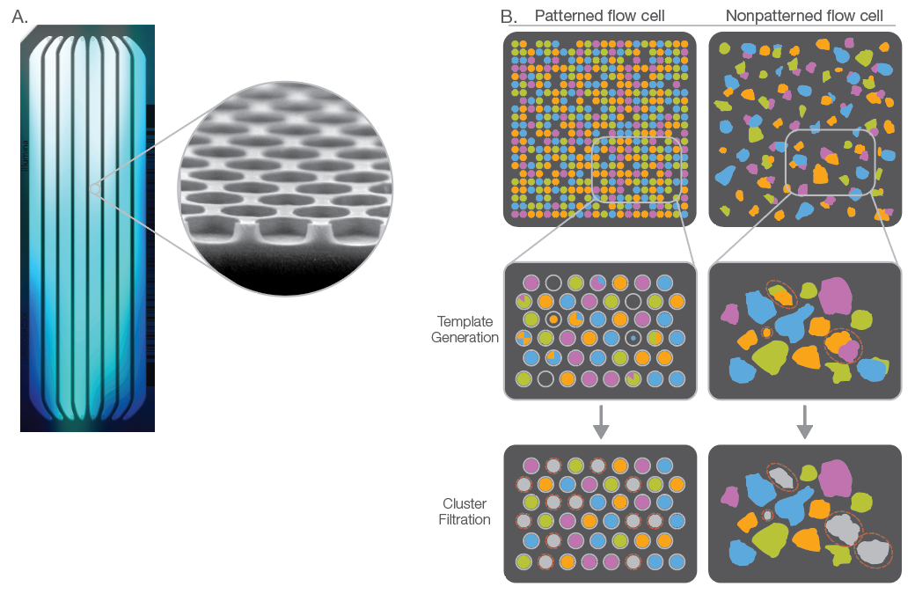
Nonpatterned flow cells can lead to greater data loss due to over-clustering

Slide 9
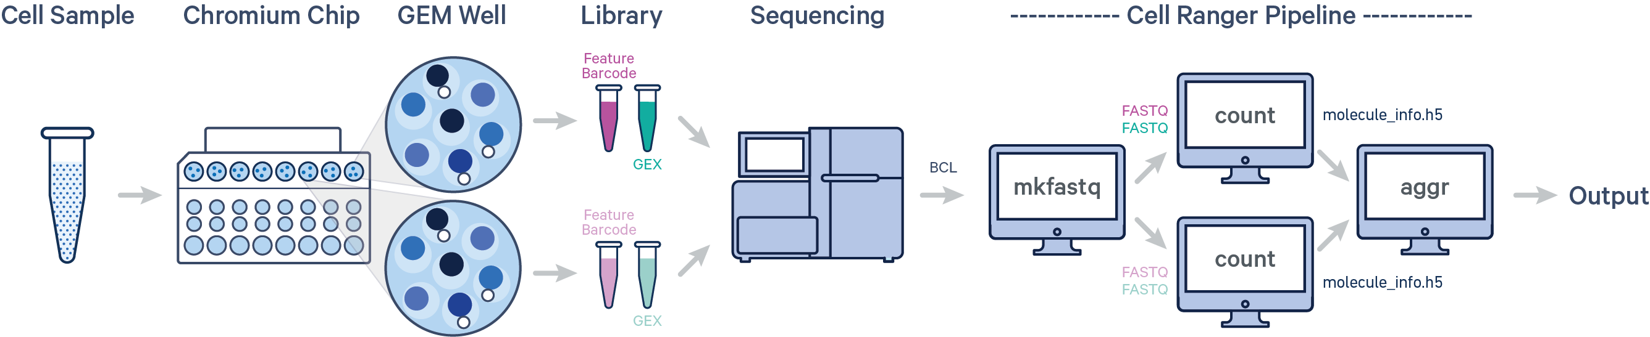
Going from raw sequencing files to gene count matrices

Slide 10
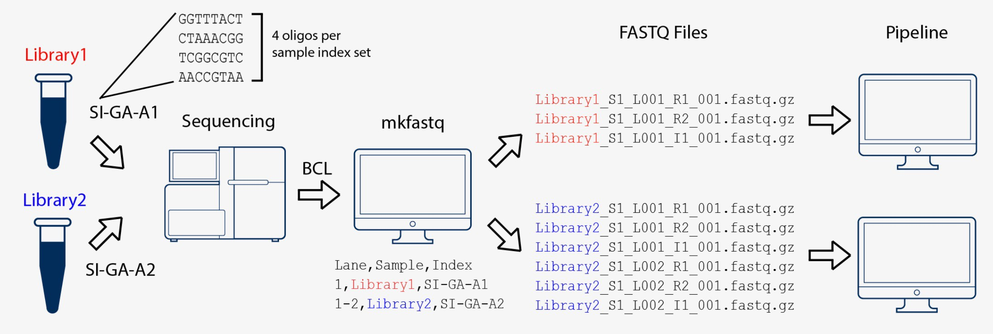
Raw sequencing files to count matrices
Step 1: BCL to FASTQ
The primary output of Illumina sequencing instruments are per-cycle base call files in BCL format.
The first step is to convert these BCL files to fastq files. Steps include separating reads into individual fastq files based on their barcode (demultiplexing) and moving unique molecular identifier (UMI) bases from the read to the fastq header.
Tools: cellranger mkfastq, bcl2fastq or BCL Convert
Source: 10X Genomics

Slide 11
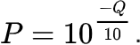
Raw sequencing files to count matrices
Step 1: BCL to FASTQ
A FASTQ file is a text file that contains the sequence data which consists of:
A sequence identifier with information about the sequencing run and the cluster.
The sequence (the base calls; A, C, T, G and N).
A separator, which is simply a plus (+) sign.
The base call quality scores as phred scores
Example sequence in a FASTQ
@HWI-ST808:130:H0B8YADXX:1:1101:2088:2222:CELL_GGTCCA:UMI_CCCT AGGAAGATGGAGGAGAGAAGGCGGTGAAAGAGACCTGTAAAAAGCCACCGN
+
@@@DDBD>=AFCF+<CAFHDECII:DGGGHGIGGIIIEHGIIIGIIDHII#

Slide 12
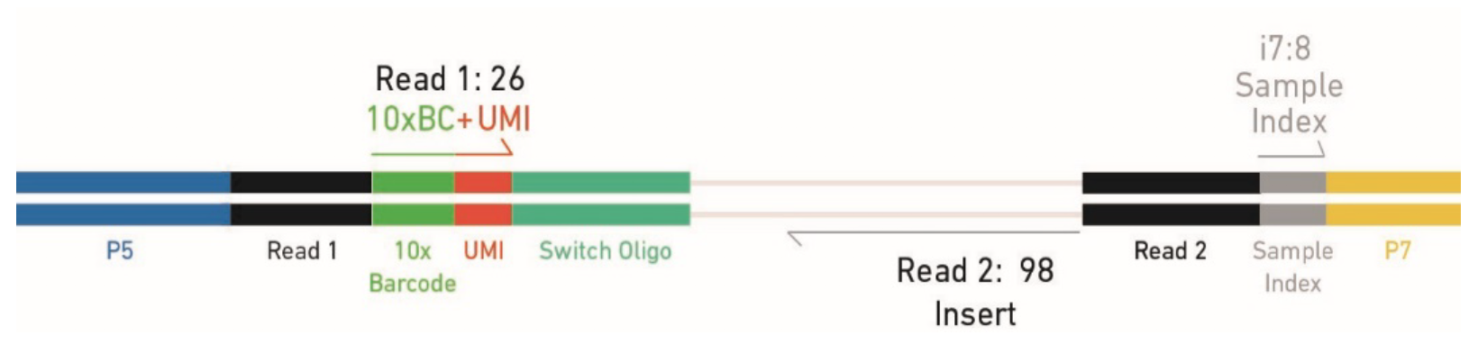
Raw sequencing files to count matrices
Step 1: BCL to FASTQ
Each fastq file generated by bcl2fastq contains different information:
I1.fastq contains sample index (for pooling together multiple samples)
R1.fastq contains cell barcode + UMI
R2.fatsq contains transcript information
R1.fastq
R2.fastq
I1.fastq

Slide 13
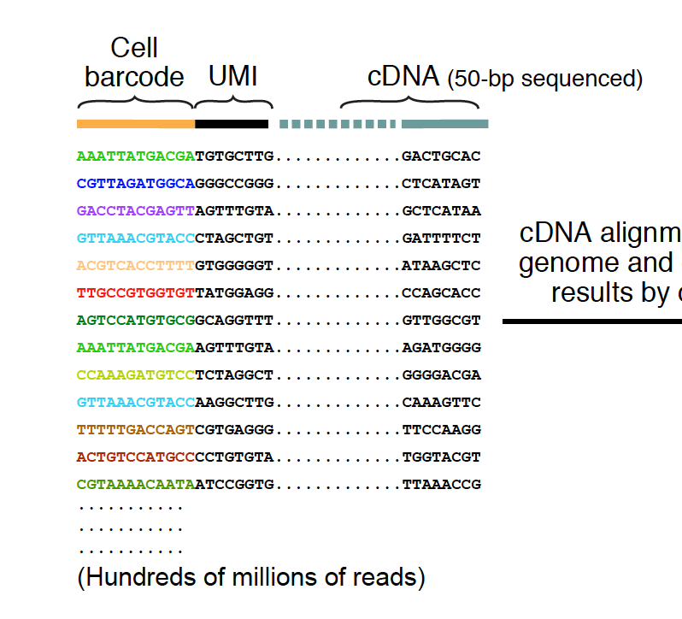
Raw sequencing files to count matrices
Step 1: BCL to FASTQ
Each fastq file generated by bcl2fastq contains different information:
I1.fastq contains sample index (for pooling together multiple samples)
R1.fastq contains cell barcode + UMI
R2.fatsq contains transcript information
R1.fastq
R2.fastq
An example of what the reads look like…

Slide 14
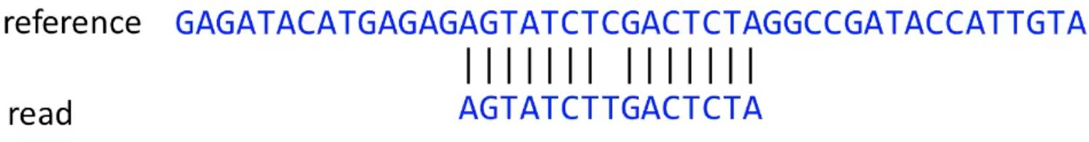
Raw sequencing files to count matrices
Step 2: Alignment to reference genome
The next step is to determine which gene each read originated from. In order to do this the read sequences are mapped to a precompiled genome reference.
Be mindful of reference versions and sources. Use the latest reference when possible.
Human reference, GRCh38 (GENCODE v32/Ensembl 98)
Mouse reference, mm10 (GENCODE vM23/Ensembl 98)

Slide 15
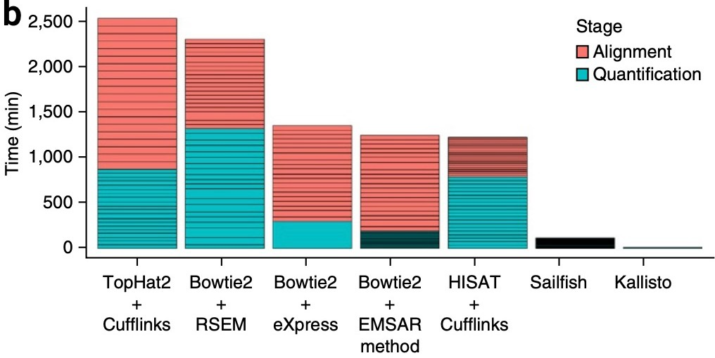
Raw sequencing files to count matrices
Step 2: Alignment to reference genome
The choice of aligner is often a personal preference and also dependent on the computational resources that are available to you.
https://hbctraining.github.io

Slide 16
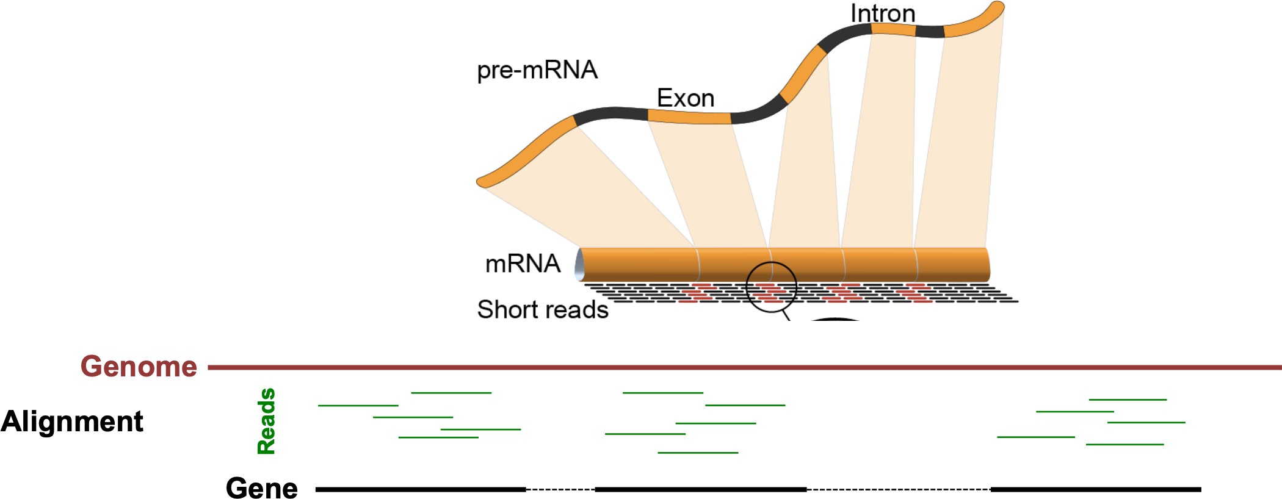
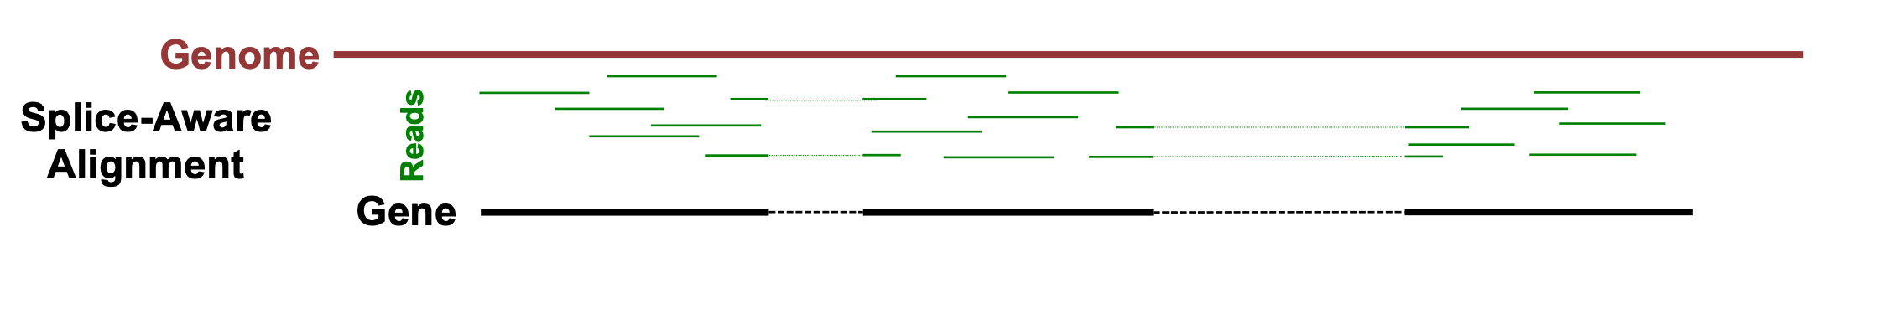
Raw sequencing files to count matrices
Step 2: Alignment to reference genome
10X Cellranger uses the STAR aligner.
Because of widespread splicing in animal genomes, read alignment against a genome should be done with a splice-aware aligner.
https://hbctraining.github.io

Slide 17
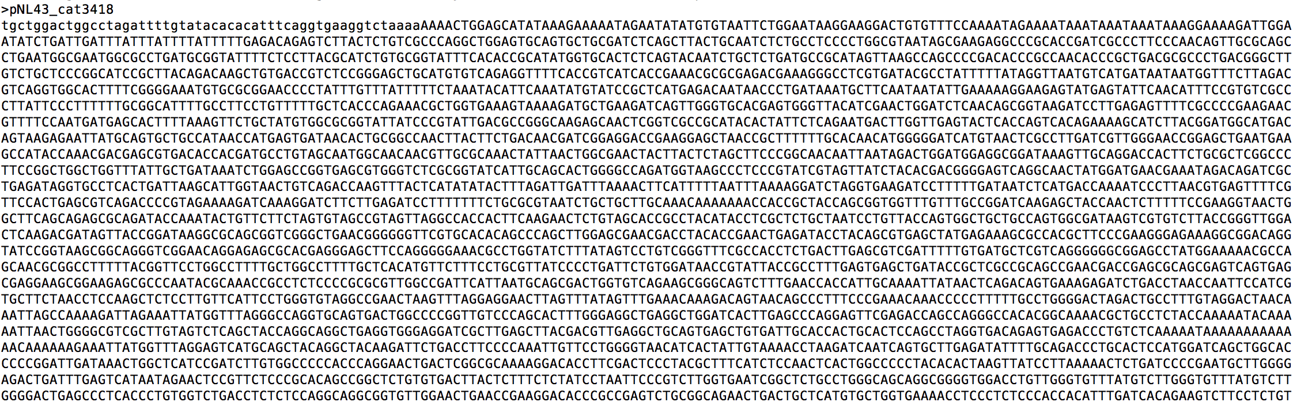
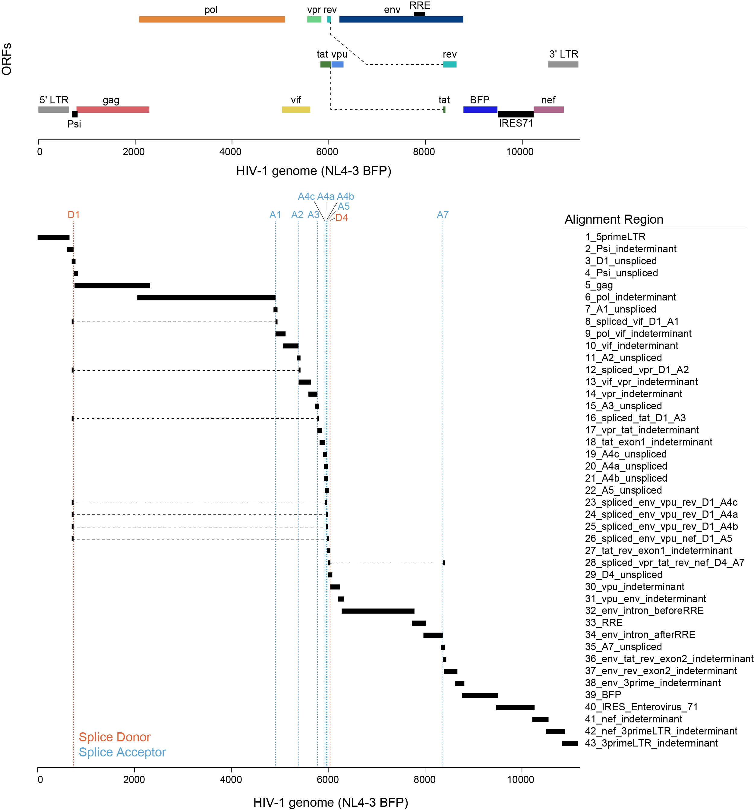
Raw sequencing files to count matrices
Step 2: Alignment to reference genome
Reference genomes can be customized to also detect “non-host” transcripts
Virus: poly-adenylated virus (e.g. HIV-1, Ebola, SARS-CoV2)
Artificial constructs: CAR, GFP, etc.
Simple approach: just adding the lentivirus as a single .fasta and full .gtf, gives binary + virus or - virus
Complex approach: annotating splice sites to understand HIV-1 life cycle

Slide 18
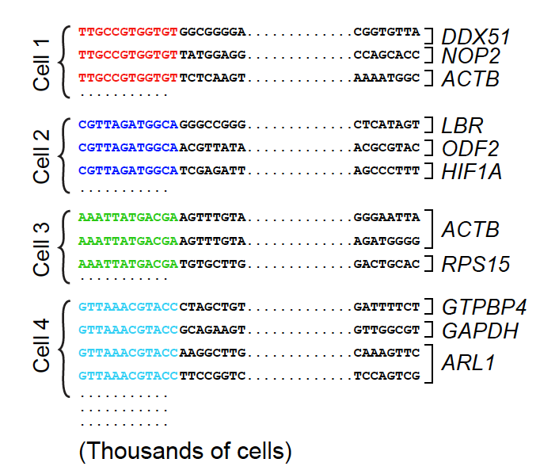
Raw sequencing files to count matrices
Step 3: Counting reads
Reads that have been confidently mapped to the transcriptome are then assigned to cells based on their barcode (cell barcode demultiplexing) and the the number of unique RNA molecules corresponding to each gene within each cell are counted (UMI deduplication).

Slide 19
Raw sequencing files to count matrices
Step 3: Counting reads
Reads that have been confidently mapped to the transcriptome are then assigned to cells based on their barcode (cell barcode demultiplexing) and the the number of unique RNA molecules corresponding to each gene within each cell are counted (UMI deduplication).
The result is the gene x cell matrix that is the starting point for downstream analysis.

Slide 20
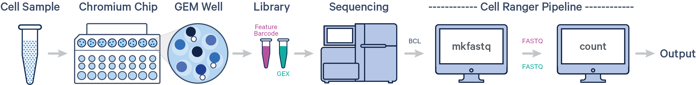
For 10X Genomics, the CellRanger pipeline can be used for all the above steps
Source: 10X Genomics

Slide 21
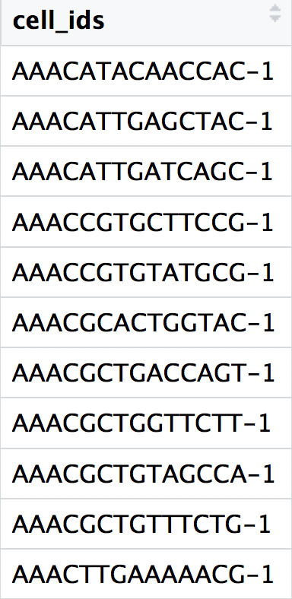
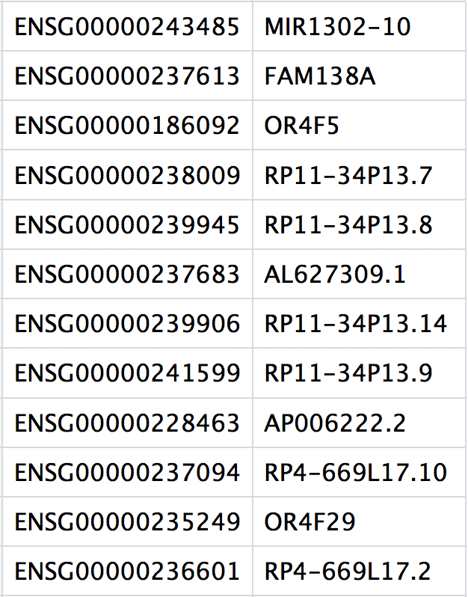
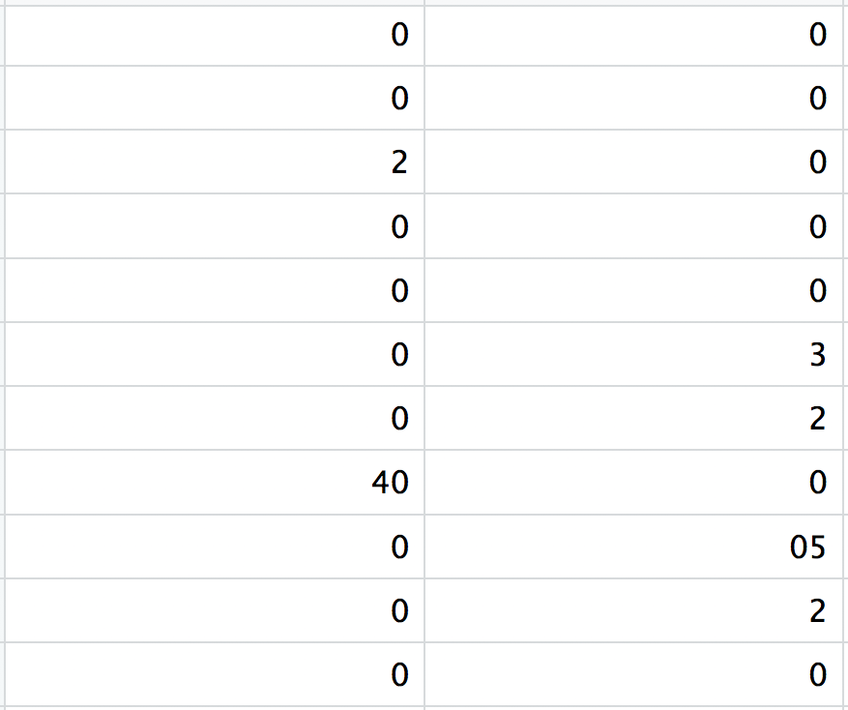
For 10X Genomics, the CellRanger pipeline can be used for all the above steps
Cellranger Outputs
barcodes.tsv
features.tsv
matrix.mtx
Contains all cellular barcodes present. Barcodes are listed in the order of data presented in the matrix file (i.e. these are the column names)
Contains the identifiers of the mapped genes. The gene identifier can vary depending on the reference used (Ensembl, NCBI). The order of the genes correspond to the order of rows in the matrix (i.e. these are the row names)
Text file which contains a matrix of count values. Rows are associated with gene IDs and columns correspond to cellular barcodes. Note that there are may zeros in the matrix
Source: 10X Genomics

Slide 22
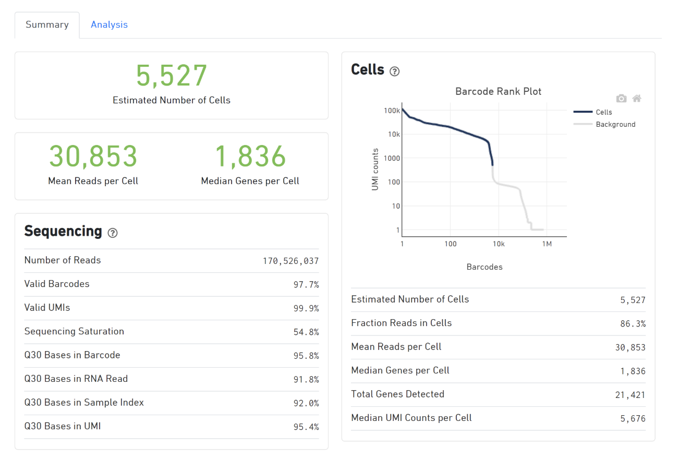
Additionally, CellRanger provides a web summary of single cell expression assays
Key metrics.
Green = expected range
Yellow/red = errors/warnings
A representative web summary file from PBMCs sample targeting 5,000 cells from a healthy donor.
Source: 10X Genomics
Notes:
https://cdn.10xgenomics.com/image/upload/v1660261286/support-documents/CG000329_TechnicalNote_InterpretingCellRangerWebSummaryFiles_RevA.pdf

Slide 23
Additionally, CellRanger provides a web summary of single cell expression assays
Detected barcodes plotted in decreasing order of the number of associated UMIs. GEMs containing cells are expected to have a greater number of transcripts (and thus UMIs) associated with them than non-cell containing GEMs.
A representative web summary file from PBMCs sample targeting 5,000 cells from a healthy donor.
Source: 10X Genomics
Notes:
https://cdn.10xgenomics.com/image/upload/v1660261286/support-documents/CG000329_TechnicalNote_InterpretingCellRangerWebSummaryFiles_RevA.pdf

Slide 24
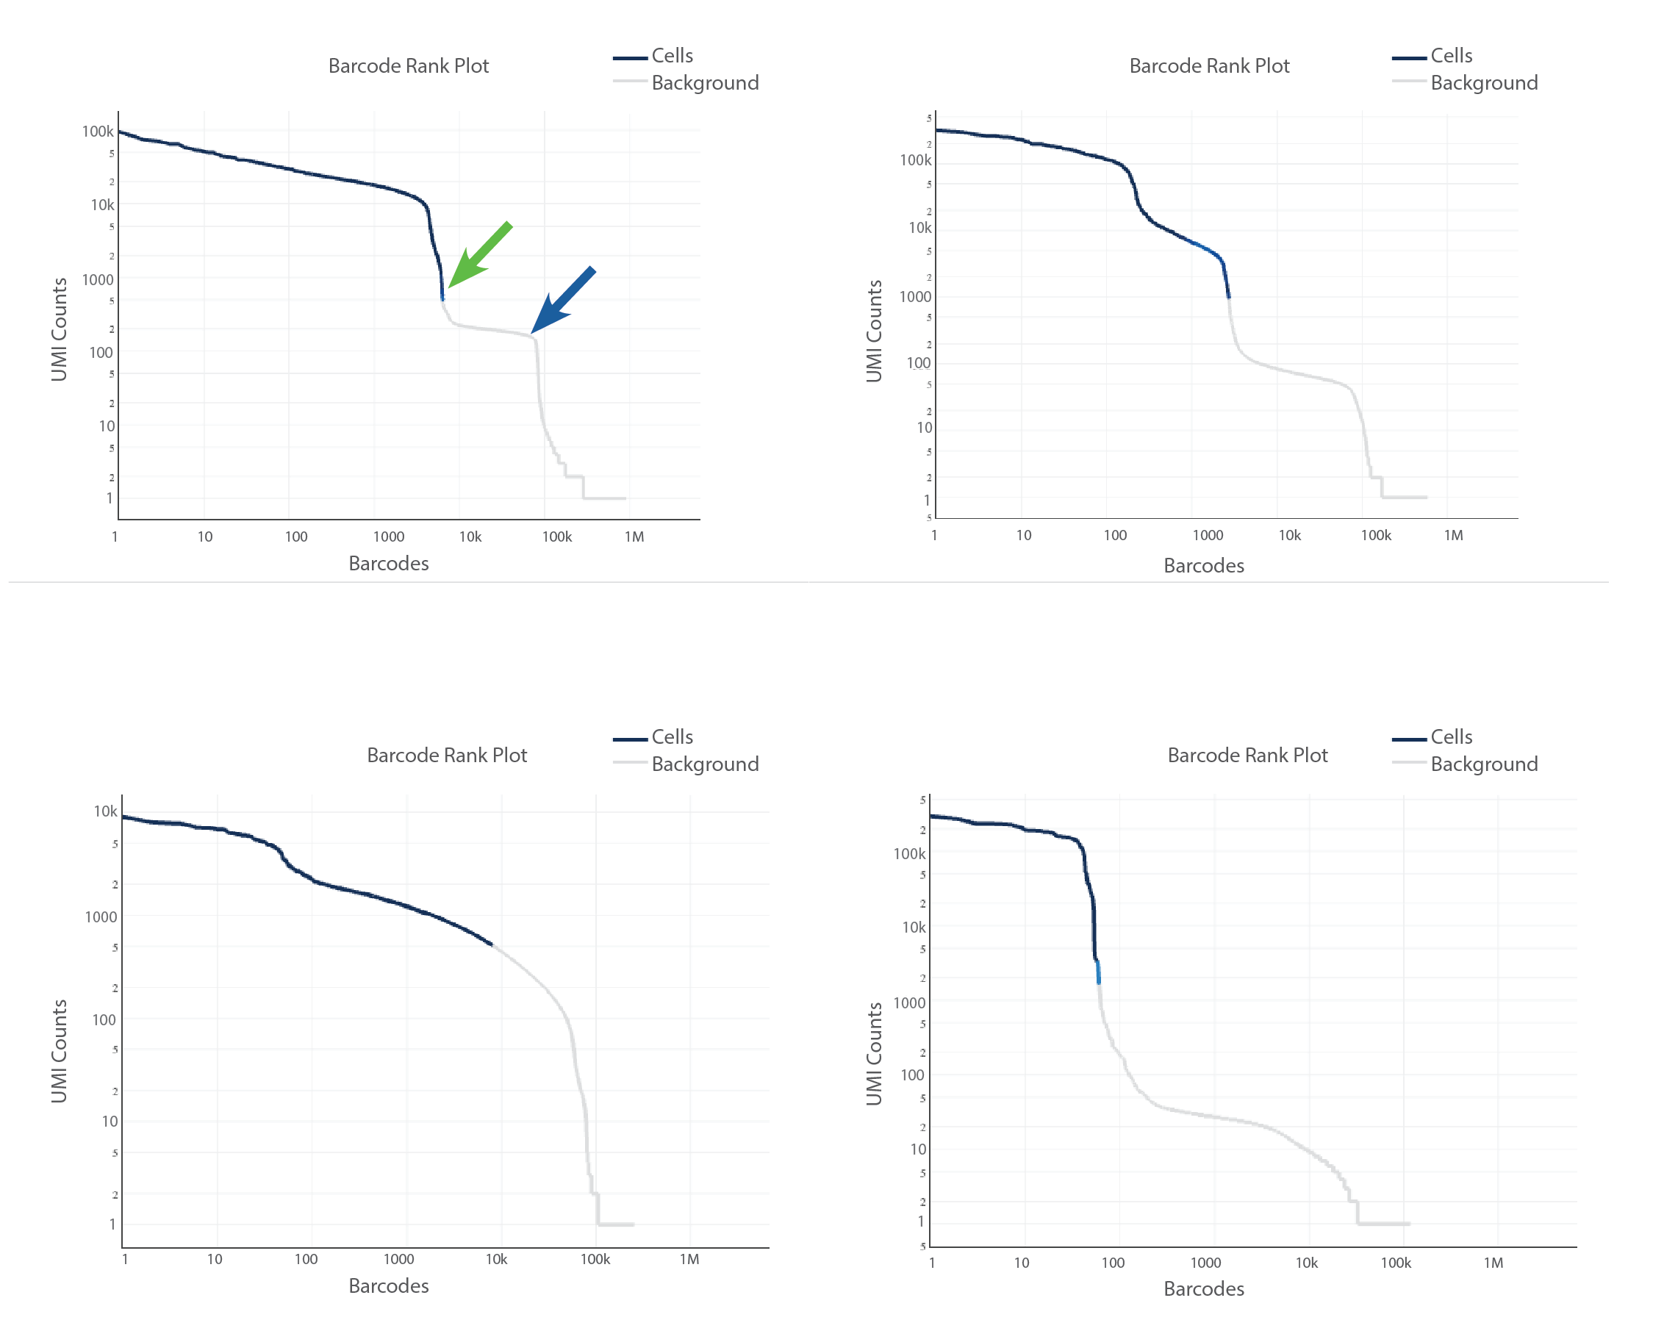
Additionally, CellRanger provides a web summary of single cell expression assays
Typical Samples
Heterogenous Samples
Typical samples – a steep drop-off indicates separation between the cell-associated barcodes and empty GEMs
Heterogenous samples – heterogenous populations can result in a bimodal plot. However, there should still be clear separation between cells and empty GEMs
Compromised Samples
Compromised samples – round curve may indicate low sample qualiy or loss of single-cell behavior due to wetting failure, premature lysis or low viability
Compromised samples – number of cell-associated barcodes lower than expected may indicate sample clog of inaccurate cell count
Source: 10X Genomics

Slide 25
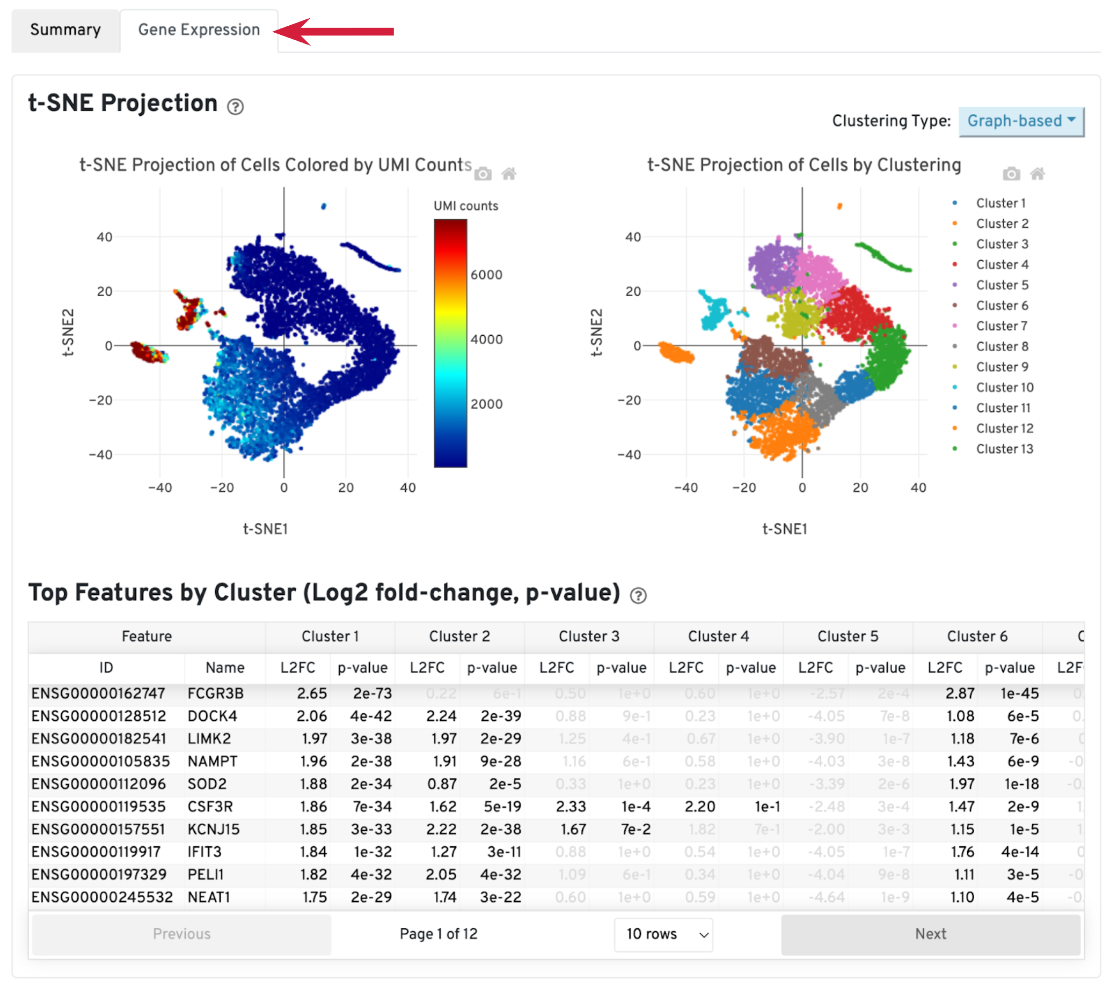
Additionally, CellRanger provides a web summary of single cell expression assays
Source: 10X Genomics
Notes:
The library-specific analysis tab contains some information on secondary analysis, including dimensionality reduction (t-SNE), clustering, and differentially expressed genes. The goal of this tab is not for downstream analysis (which should be carried out in Loupe Browser or community developed tools), but for quickly assessing the quality of the results with some biological context.
A typical sample should have a t-SNE plot with defined structures – different clusters separated in the plot, as shown in our sample. Lack of cluster structure, or no separation (for a sample with expected heterogeneous cell populations) may indicate sample quality issues or loss of single cell behavior.
The Top Features by Cluster table shows the top differentially expressed genes in each cluster. This table is likely not sufficient for us to perform cell type annotation. However, we can use the table to assess sample quality, because poor samples have some distinct signatures. For example, if the total number of genes in the table is very small (<20), it may indicate loss of single cell behavior. If one or more clusters have many mitochondrial or ribosomal protein genes differentially expressed, it may indicate these clusters are mostly unhealthy or dead cells.

Slide 26
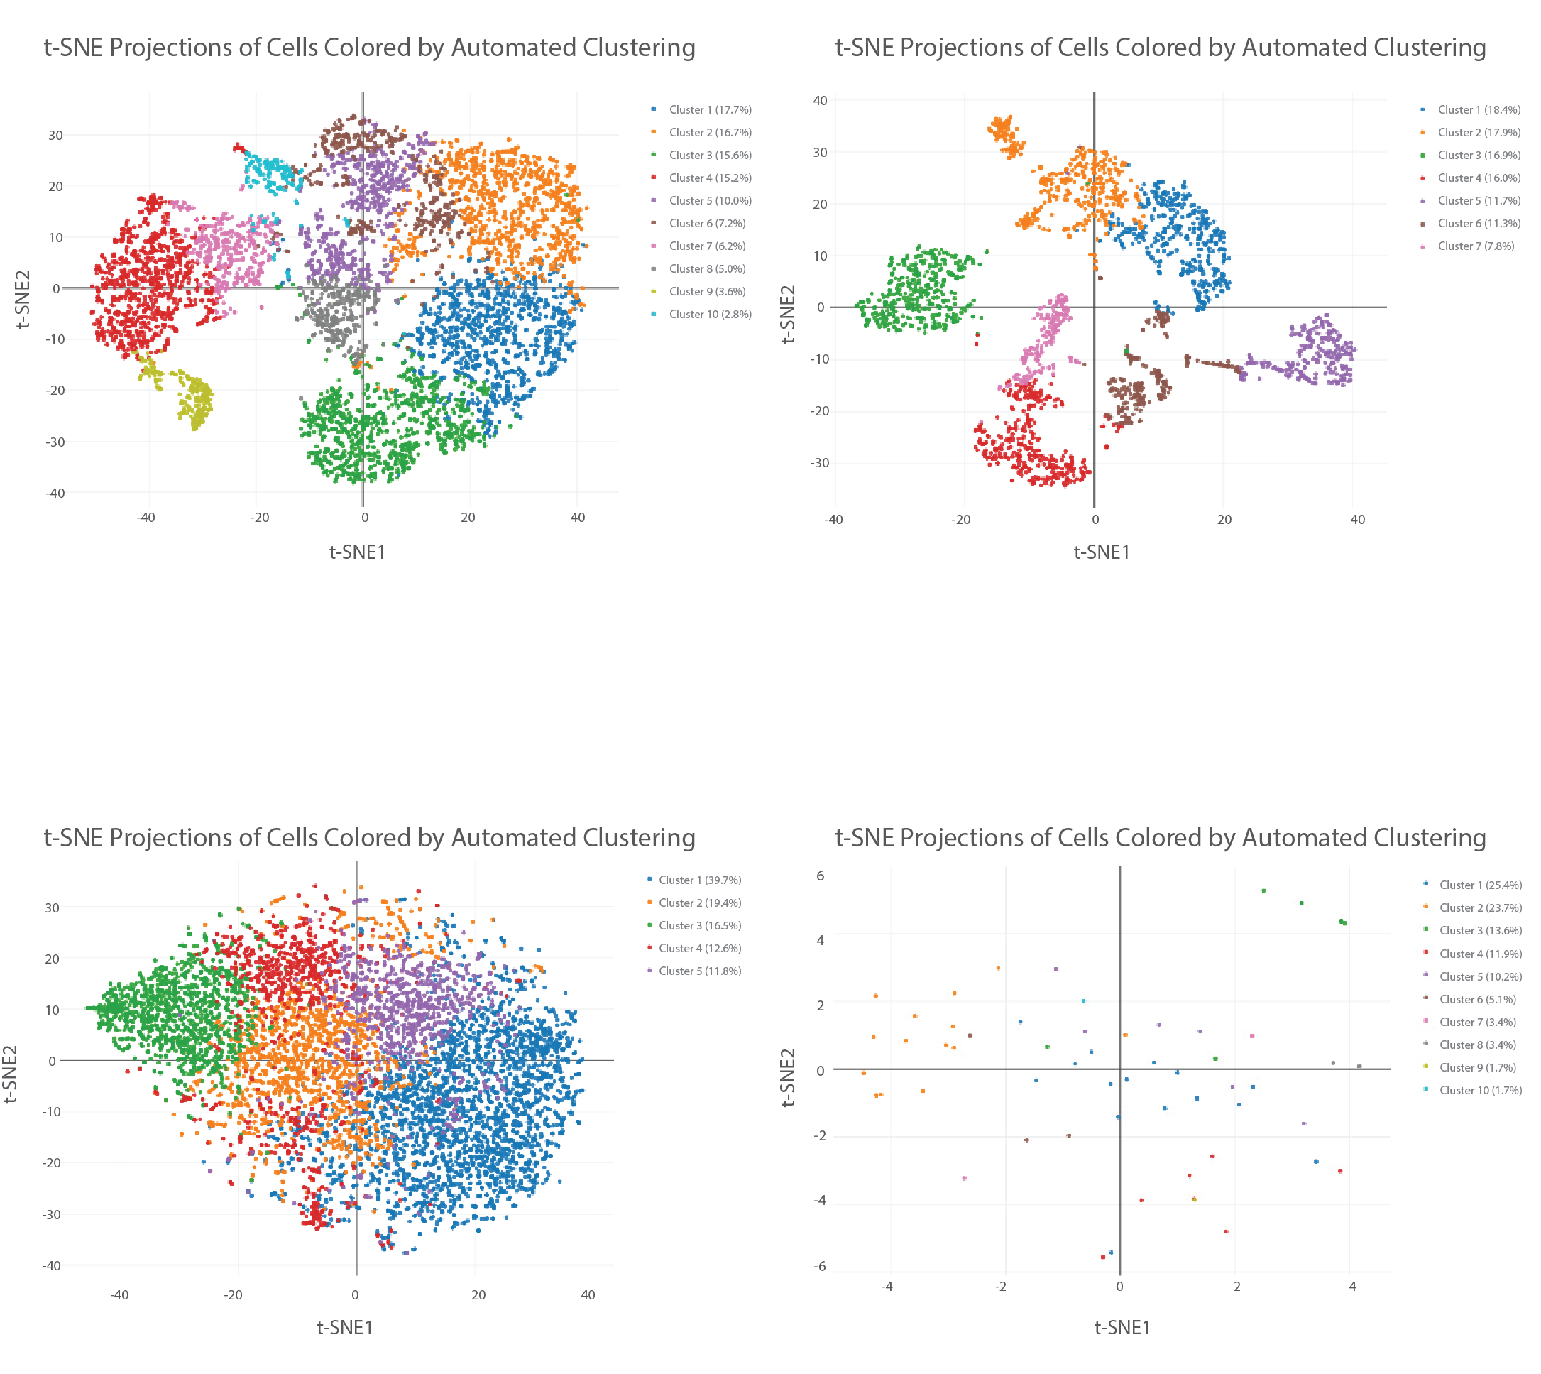
Additionally, CellRanger provides a web summary of single cell expression assays
Typical Samples
Heterogenous Samples
Typical samples + Heterogenous samples – structured clusters with good separations (for samples with heterogenous populations)
Compromised Samples
Compromised samples – lack of cluster structure, one large cluster, or no separation (for a sample with expected heterogeneous cell populations) may indicate sample quality issue or loss of single- cell behavior
Compromised samples – low cell numbers may result in scattered cell t-SNE plots with little cluster structure
Source: 10X Genomics

Slide 27
Working with count matrices
Basics of bioinformatics tool-kits in omics research
Quality control and normalization starting from gene count matrices
Interacting with single-cell data in R: Seurat objects

Slide 28
Basics of bioinformatics tool-kits in omics research.
Programming languages
R
python
package environments
Bioconductor
scverse

Slide 29
Basics of bioinformatics tool-kits in omics research.
Programming languages
R
python
package environments
Bioconductor
scverse
“Backbone” packages
Seurat / SingleCellExperiment
scanpy / anndata

Slide 30
Basics of bioinformatics tool-kits in omics research.
Programming languages
R
python
package environments
Bioconductor
scverse
“Backbone” packages
Seurat / SingleCellExperiment
scanpy / anndata
specialized packages
scRepertoire
scirpy

Slide 31
Introduction to single-cell analysis: determining cell type, state, and function
Quality control
Normalization
Feature selection
Dimensional reduction
Cell-cell distances
Unsupervised clustering
Kiselev C. at al. (2019) Nature Reviews Genetics. 20: 273-282.

Slide 32
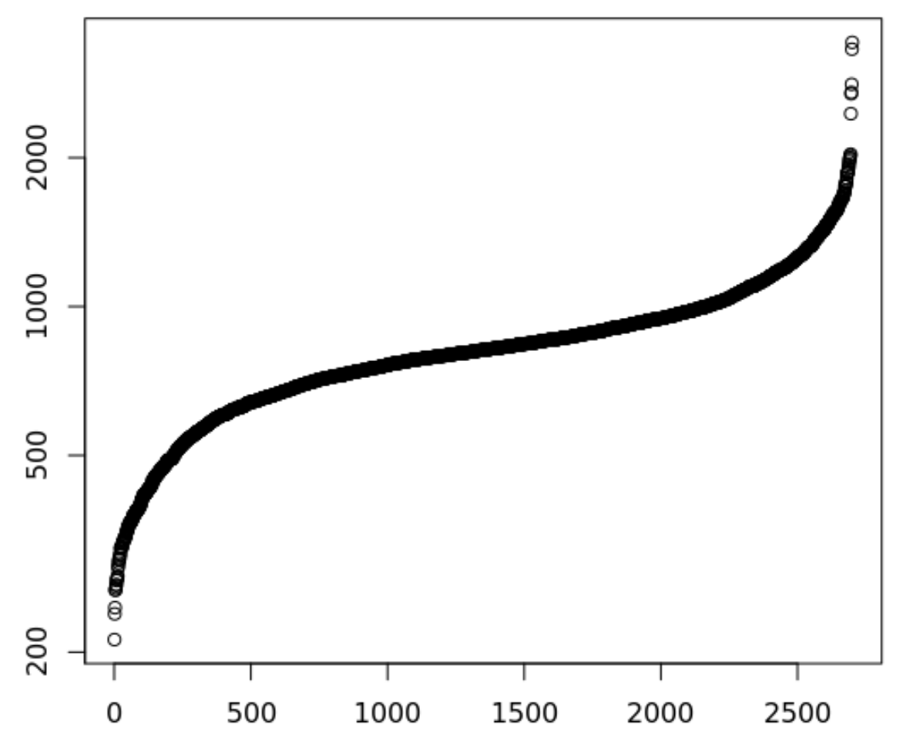
There are many quality control filters for genes and cells
Genes detected per cell (ordered)
Complexity =
Number of genes detected in a cell
Complexity
Complexity
Cell
Notes:
Filtering both ends. Lower: Failed libraries? Higher: Doublets?
Outlier cells are not just measured by complexity
•Percent Reads Mapping
•Percent Mitochondrial Reads
•Presence of marker genes
•Intergenic/ exonic rate
•5' or 3' bias
•other metadata …
•Useful Tools
Picard Tools and RNASeQC

Slide 33
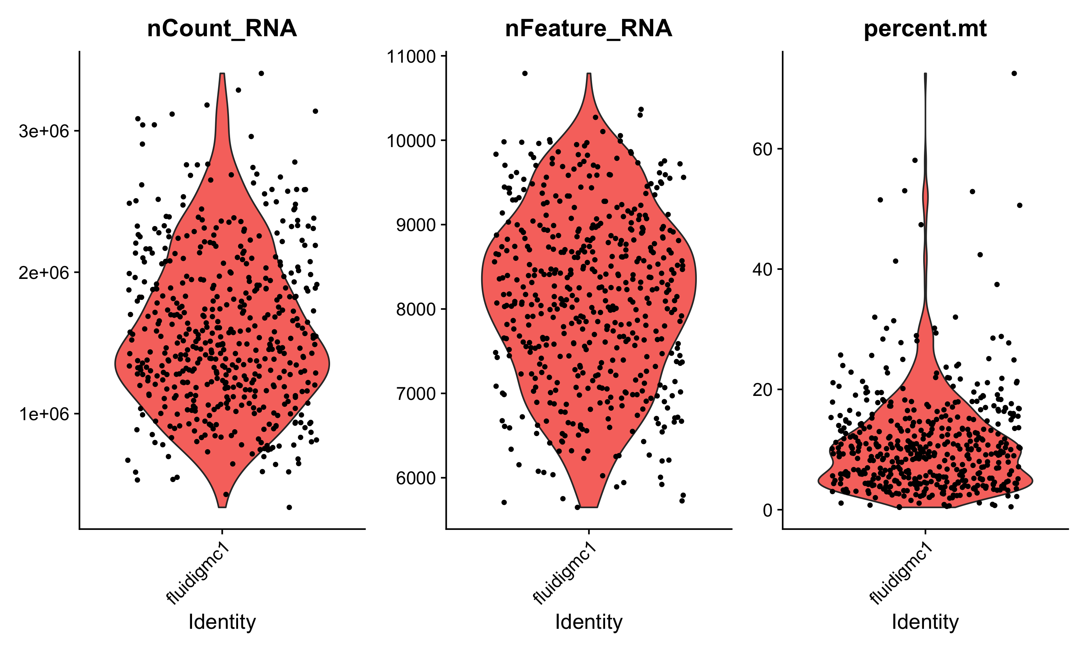
There are many quality control filters for genes and cells
We filter cells based on technical or biological parameters.
# reads or UMIs detected in a cell
# genes detected in a cell
% mito expression in a cell

Slide 34
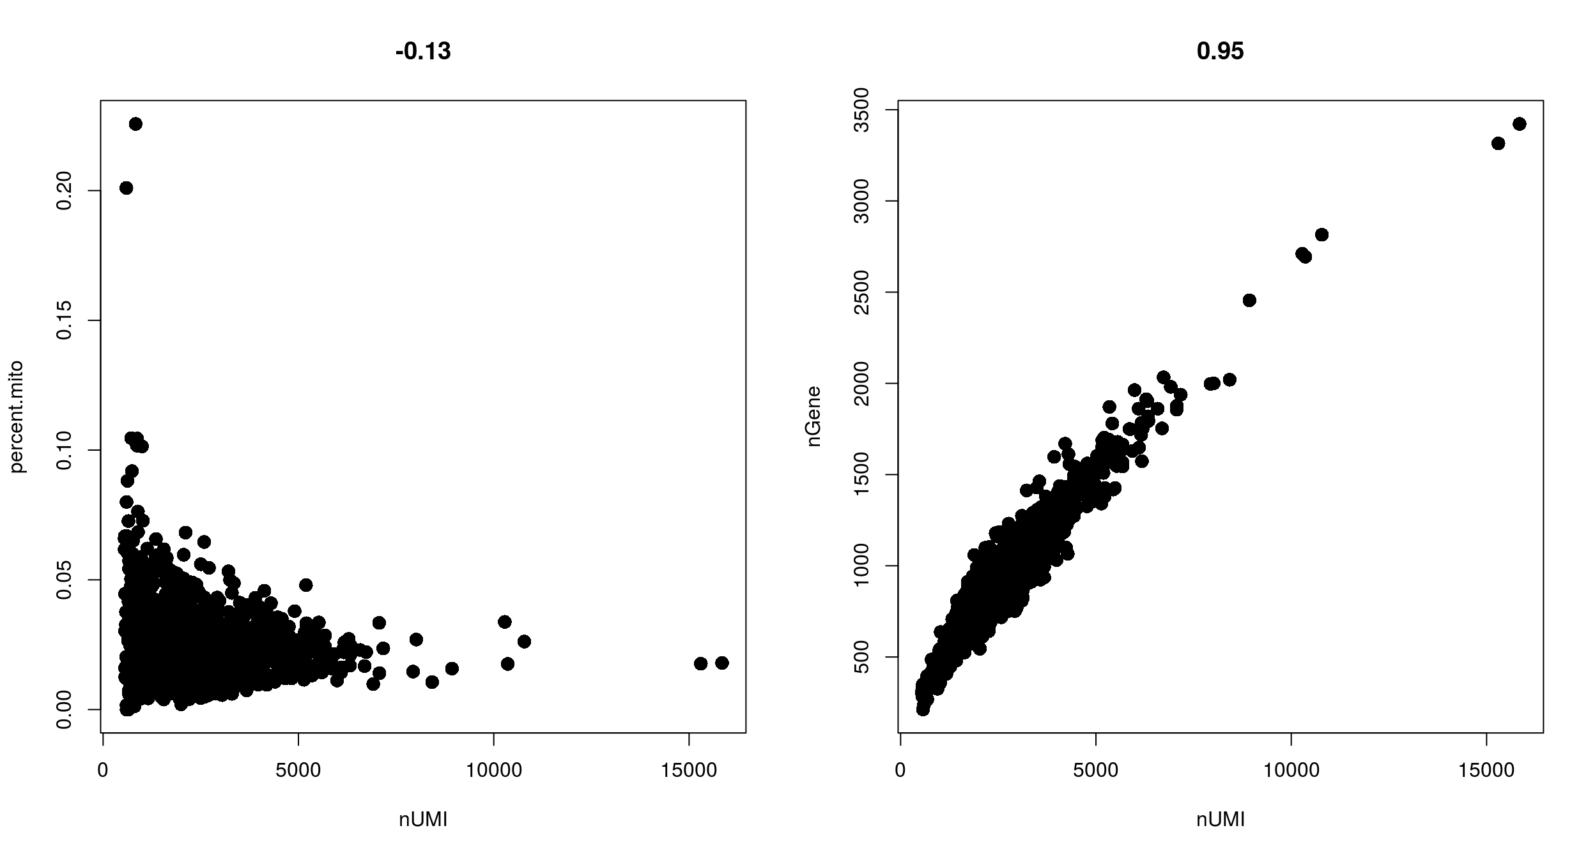
Filtering with combinations of quality control filters
Low nUMI and high % mitochondrial- Cells captured but lost a lot of the mRNA, and the mitochondrial genes were protected and retained
High nUMI & low nGene ratio – low quality library or capture rate
nGene
% mito
High nUMI & high nGene – doublets
nUMI
nUMI
Notes:
Cells got raptured and lost a lot of the mRNA, but the mitochondrial genes are protected (0.1, 10000)

Slide 35
Appropriate quality control filters vary with platform and
cell types
Different platforms set different expectations
e.g. Smart-Seq2 often yields more genes detected per cell than 10x Chromium.
Different cell types set different expectations
Immune cells normally have fewer genes detected per cell than non-immune cells
Malignant cells normally have more genes detected per cell than non-malignant cells
Notes:
Malignant cells are more transcriptional active

Slide 36
Detecting empty drops containing ambient RNA – manual
Look for transcripts expressed in unexpected cell types and remove those genes from all subsequent analysis
e.g. hemoglobin gene expressed in a T cell

Slide 37
Detecting empty drops containing ambient RNA – automatic
EmptyDrops (distinguish cells from empty droplets)
Cells ranked by total
unique molecular identifiers (UMI)
10000
1000
100
10
Cell encapsulated in droplet
Total UMI detected per cell
Mixture
Ambient RNA encapsulated in droplet
Lun, A.T.L. et al. Genome Biol (2019). 20, 63.

Slide 38
Quality control tips
We often revisit quality control decisions multiple times when analyzing data.
Start with permissive thresholds when filtering and investigate the effects of these thresholds before applying more stringent thresholds.
If the distributions of QC metrics differ between samples, thresholds should be determined separately for each sample to account for sample quality differences.
Visualize QC metrics per cell subset in order to flag technical biases.
Luecken M. D. et al. Molecular Systems Biology (2019) 15:e8746.

Slide 39
Determining cell type, state, and function
Quality control
Normalization
Feature selection
Dimensional reduction
Cell-cell distances
Unsupervised clustering
Kiselev C. at al. (2019) Nature Reviews Genetics. 20: 273-282.

Slide 40
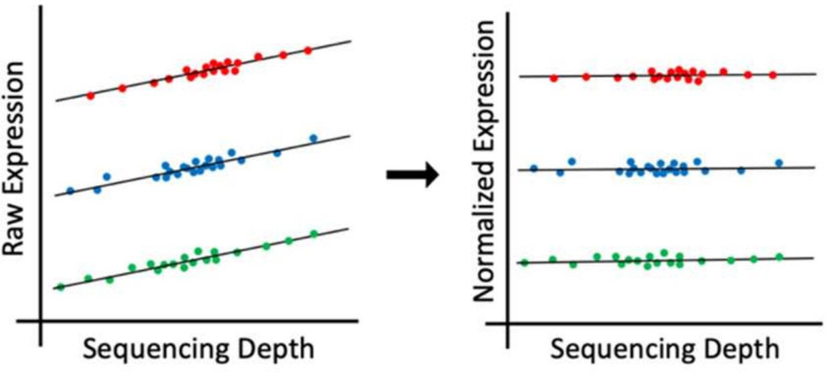
Single-cell RNA-Seq analysis: normalization
Why normalize gene expression within a cell?
Cells are sequenced to different depths (total number of molecules sequenced).
There are typically extreme values in distribution of gene expression
cell type 1
cell type 2
cell type 3
Differences in sequencing depth can lead to false differences in gene expression.

Slide 41
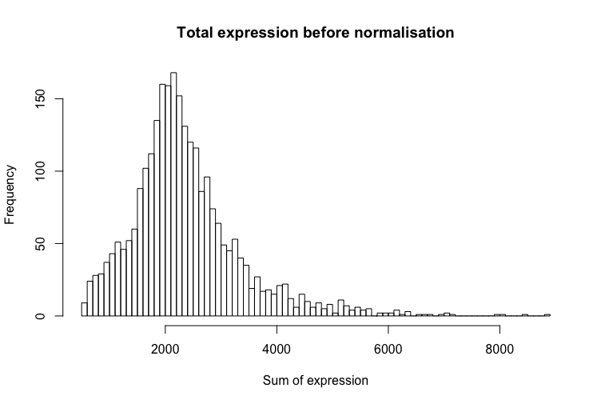
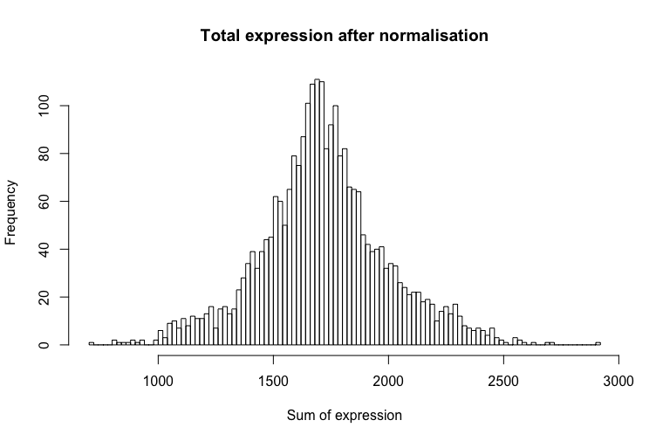
Single-cell RNA-Seq analysis: normalization
The goal of normalization is for differences in normalized read counts to represent differences in true expression.
Common normalization approach
Gene expression measurements for each cell are normalized by the total gene expression.
Gene expression values are next scaled to sum to 10,000 and then log(1+x)-transformed.
hbctraining.github.io/main
Notes:
Next we carry our normalization within each single cell. The total gene expression within a cell is the sum of the expression levels of all genes in the cell, and due to technical reasons, the total gene expression across individual cells often varies a lot. This is a confounding factor in analysis.

Slide 42
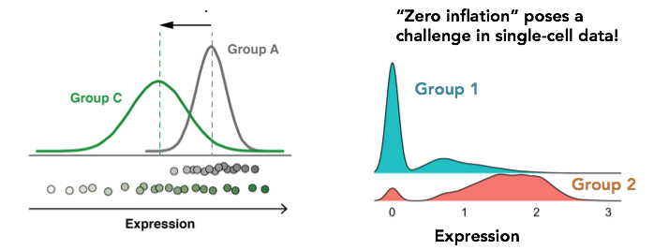
Is standard normalization appropriate?
Reassessing the idea that droplet scRNA-Seq is zero-inflated.
“Droplet scRNA-seq is not zero-inflated.” Svensson, Nature Biotechnology (2020)
”Feature selection and dimension reduction for single-cell RNA-Seq based on a multinomial model.” Townes et al. Genome Biology (2019)
“Normalization and variance stabilization of single-cell RNA-seq data using regularized negative binomial regression.” Hafemeister et al. Genome Biology (2019)
Single
cell
Bulk

Slide 43
Determining cell type, state, and function
Quality control
Normalization
Feature selection
Dimensional reduction
Cell-cell distances
Unsupervised clustering
Kiselev C. at al. (2019) Nature Reviews Genetics. 20: 273-282.

Slide 44

Single-cell RNA-Seq analysis: feature selection
gene 2
Cells are in 20,000 dimensional space (one dimension for each gene), but hard to visualize!
gene 1
gene 3
Genes with highly variable expression contain biological signal related to cell states.
Many genes are lowly detected or noisy measurements.
We typically select 2,000-5,000 variable genes.
Be mindful when you work on dataset containing TCR/BCR or exogenous (e.g. viral or artificial constructs) transcripts
Notes:
Next we carry out feature selection, In this cartoon, cells are in 3D space with each cell localized based on its expression of genes 1,2,3. In reality cells are in 20K dimensional space (genes in human genome) but this is hard to visualize, and it is very difficult to cluster cells in higher-dimensional space. To reduce the dimensionality of the data, we only use those genes whose expression levels are highly variable across individual cells. The intuition is that a gene that has the same expression across all cells will not distinguish different T cell states, while genes that are high in one state and low in another state are informative. This is the feature selection. We typically select 2000-5000 most highly variable genes.

Slide 45
Single-cell RNA-Seq analysis: feature selection
CV (counts)
Mean counts
Find genes (features) that are outliers in a plot of mean of gene expression vs variance of gene expression

Slide 46
Determining cell type, state, and function
Quality control
Normalization
Feature selection
Dimensional reduction
Cell-cell distances
Unsupervised clustering
Kiselev C. at al. (2019) Nature Reviews Genetics. 20: 273-282.

Slide 47
Dimensionality reduction
Cells are in ~20,000 dimensional space
many genes are lowly detected / noisy measurements
genes are not independent of one another! rather they operate in coregulatory modules
curse of dimensionality
Principle component analysis moves us from describing cells with 20,000 gene expression values to 10-100 principal component scores

Slide 48
Dimensionality reduction
One approach to simplification is to assume that the data of interest lies within lower-dimensional space. If the data of interest is of low enough dimension, the data can be visualised in the low-dimensional space.
Common Techniques
Principal Component Analysis (PCA)
Independent Component Analysis (ICA)
Multidimensional Scaling (MDS)
Non-negative Matrix Factorization (NMF)
Probabilistic Modeling (e.g. Latent Dirichlet Allocation - LDA)

Slide 49
Determining cell type, state, and function
Quality control
Normalization
Feature selection
Dimensional reduction
Cell-cell distances
Unsupervised clustering
Kiselev C. at al. (2019) Nature Reviews Genetics. 20: 273-282.

Slide 50
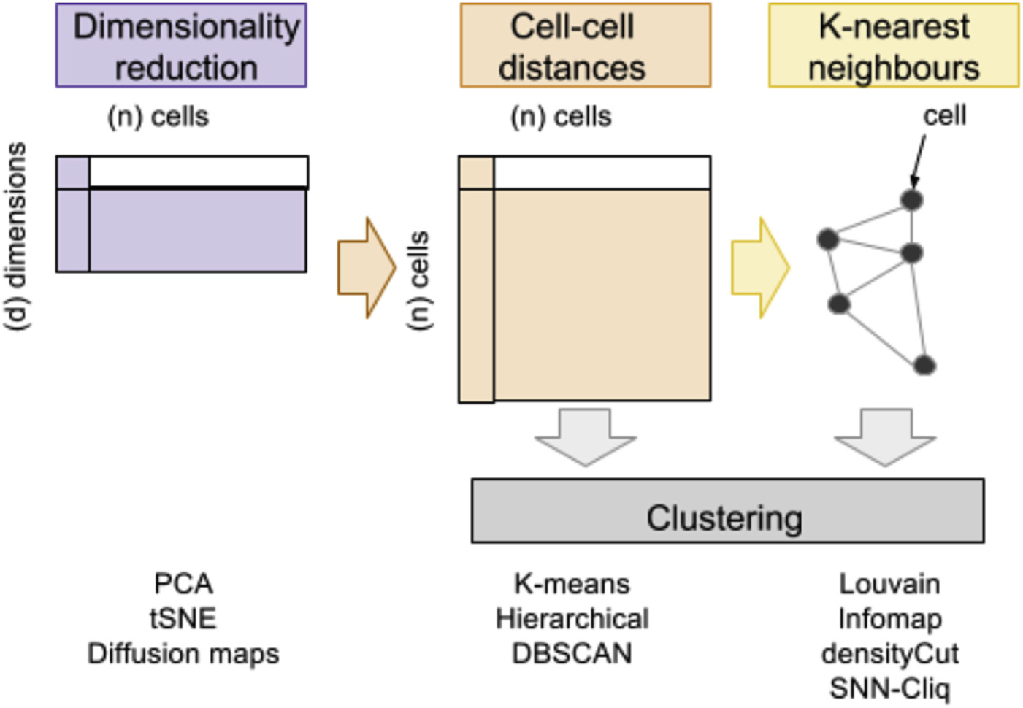
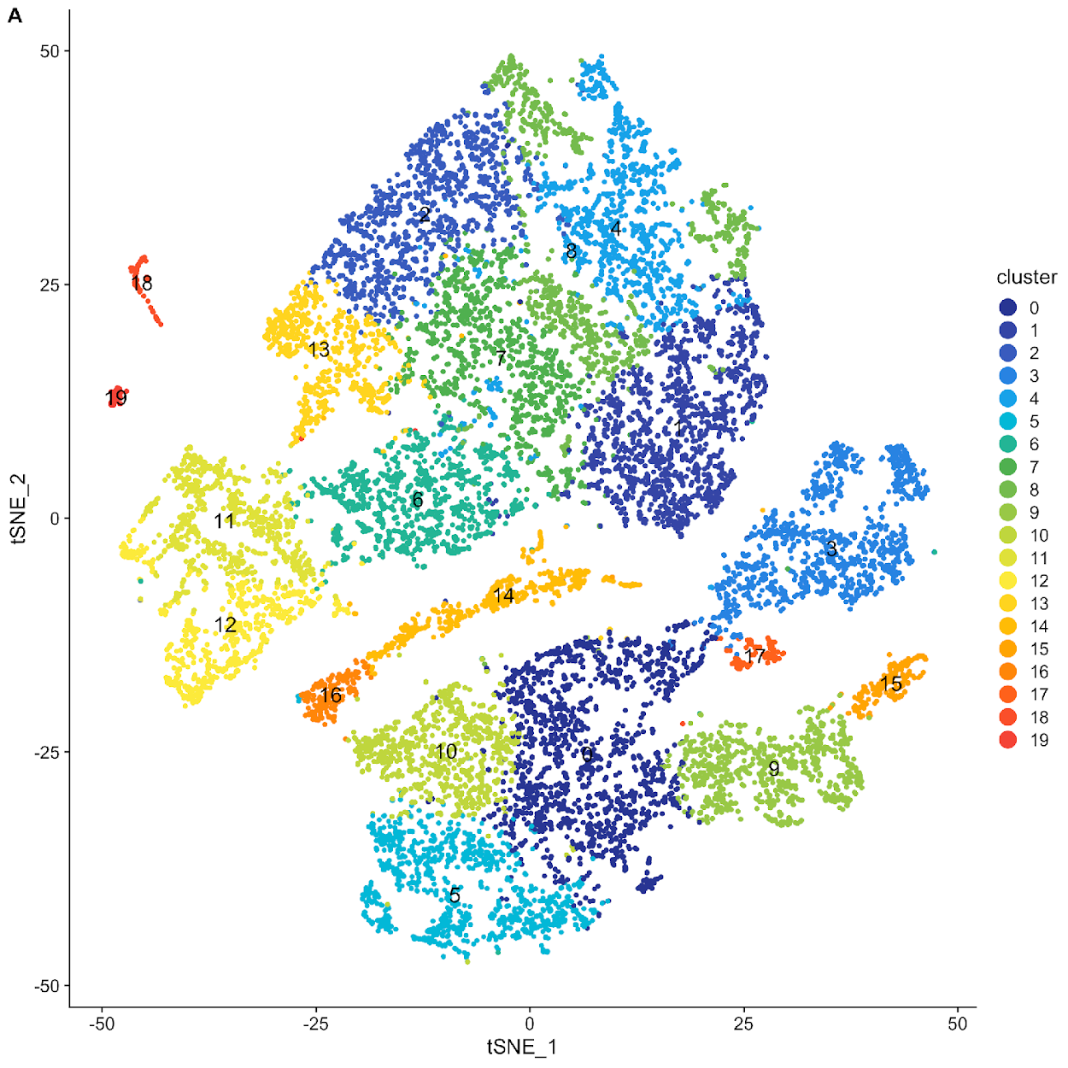
Clustering in KNN graphs
Andrews, Tallulah S. at al. (2017) Molecular aspects of medicine.

Slide 51


KNN graph

Slide 52
KNN graph
1

Slide 53
KNN graph
1
2

Slide 54
KNN graph
1
3
2

Slide 55
KNN graph
4
1
3
2

Slide 56
KNN graph
4
1
3
2
4
1
3
2

Slide 57
KNN graph

Slide 58
Determining cell type, state, and function
Quality control
Normalization
Feature selection
Dimensional reduction
Cell-cell distances
Unsupervised clustering
Kiselev C. at al. (2019) Nature Reviews Genetics. 20: 273-282.

Slide 59
Clustering in KNN graph

Slide 60
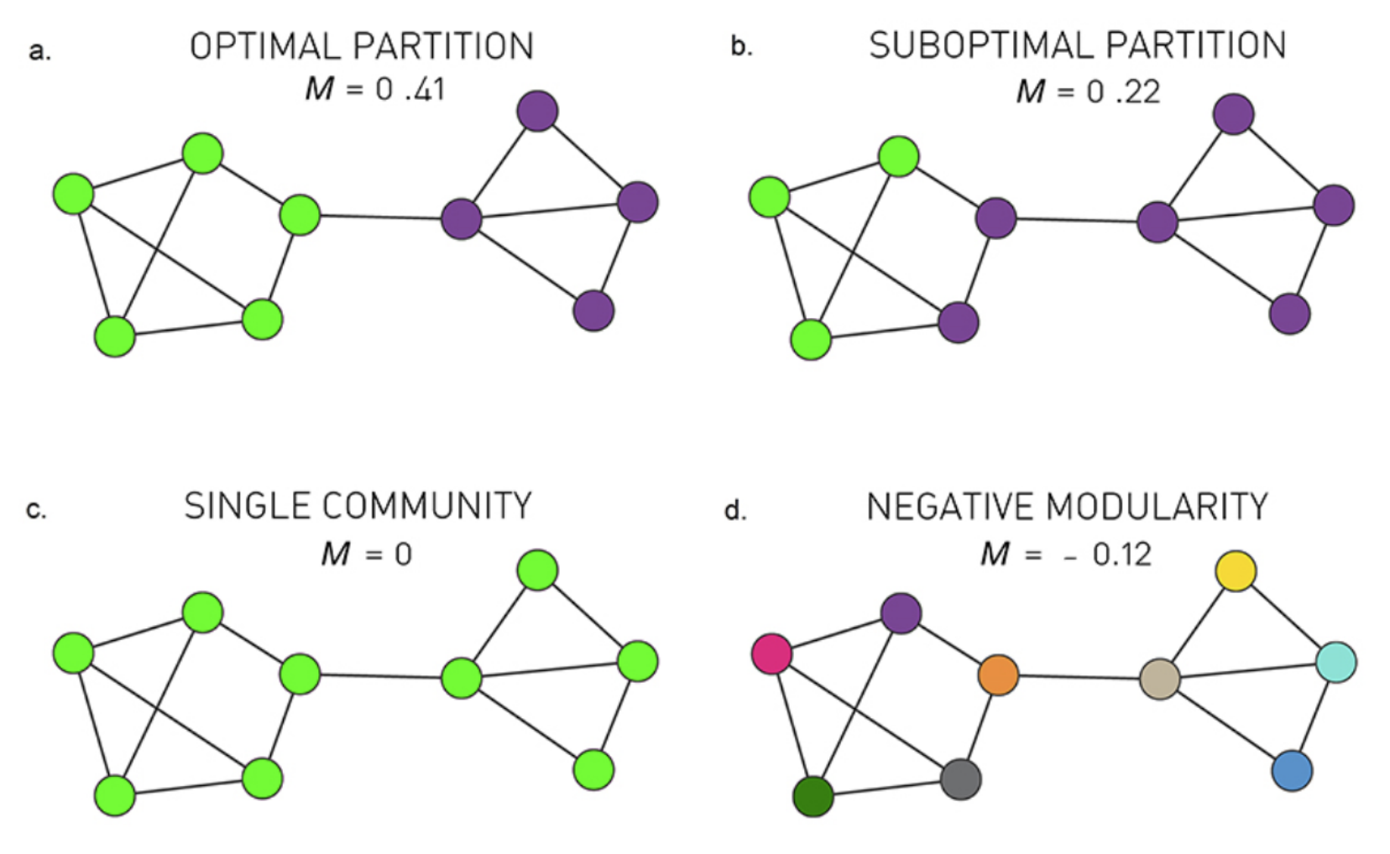
Clustering in KNN graph
Graph-based clustering is based on community detection.
Many different algorithms for community detection:
Louvain (heuristic), Infomap, Walktrap
Most of them are based on modularity maximization

Slide 61
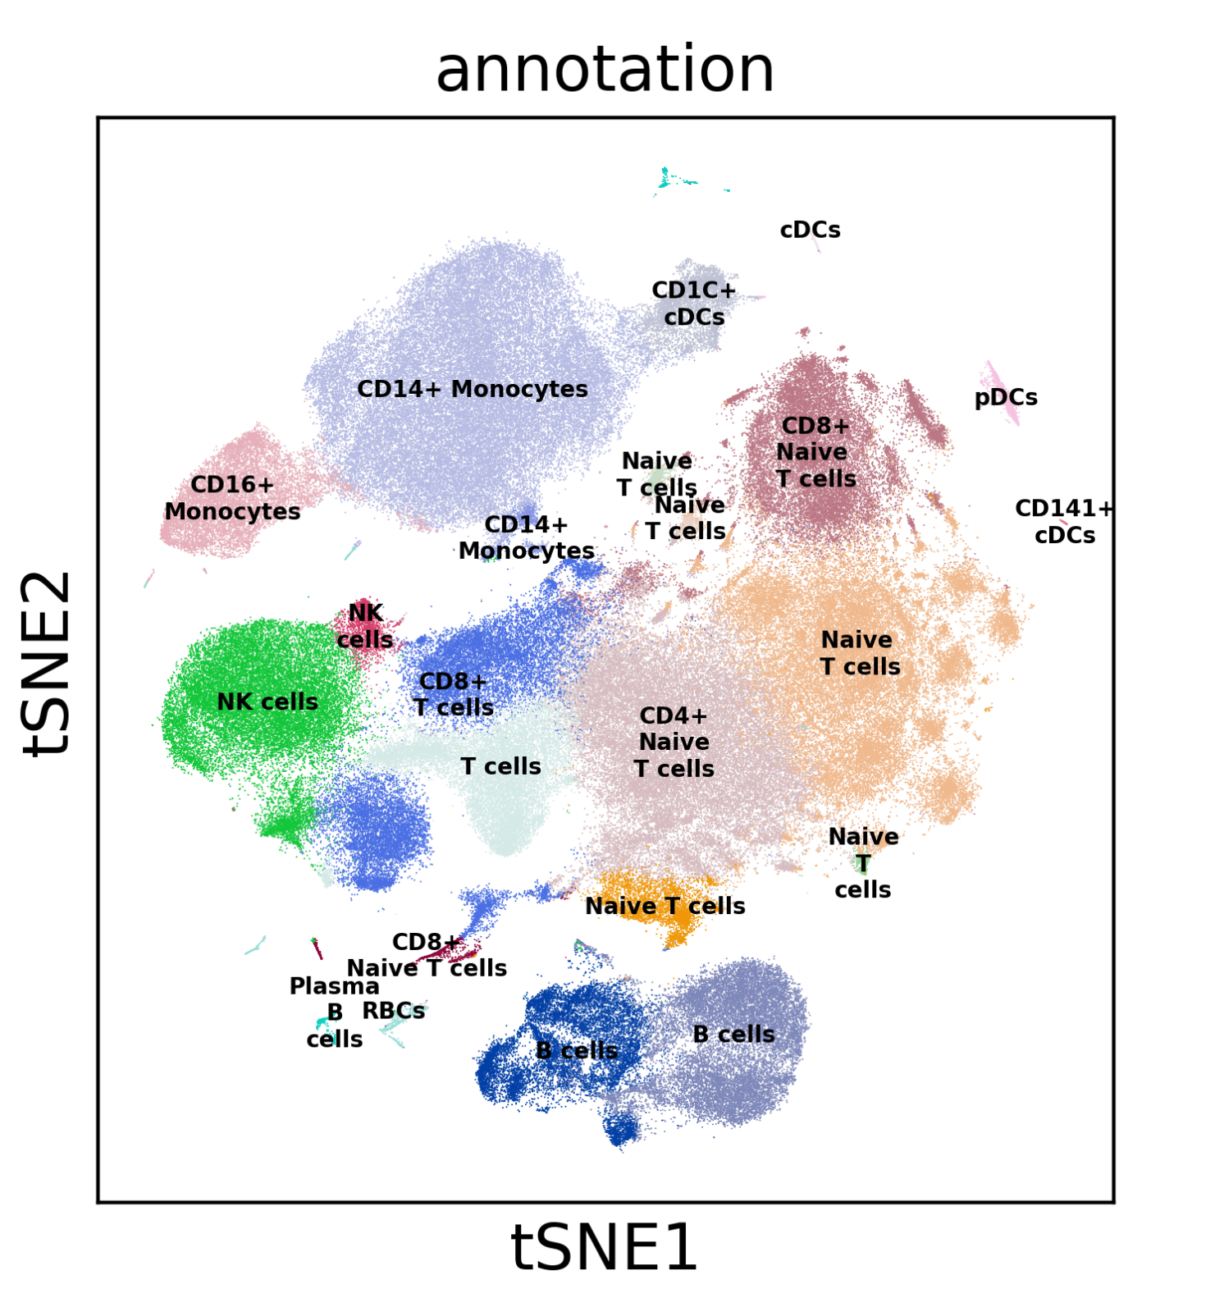
Single-cell RNA-Seq analysis: Cell state annotation
500K immune cells collected from healthy humans.
Immune cells are colored by their cluster identity and visualized in a tSNE embedding.
Cell types are identified by inspecting genes differentially expressed in one cluster relative to other clusters.

Slide 62
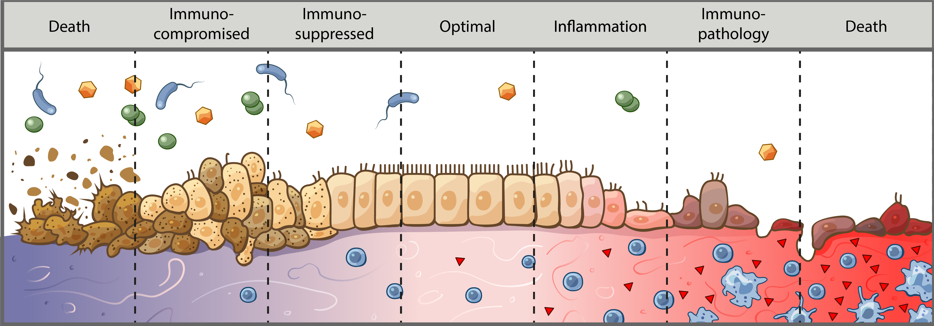
What are we actually annotating?
Cells exist along multiple continuums
Ex. Differentiation, inflammatory response, anti-viral response, EMT transition
Conventional profiling techniques puts cells into “buckets”
Unbiased approaches allows us to appreciate how cell types/states relate to each other along a spectrum
We have a hard time conceptualizing this spectrum—so we need to annotate cells similarly to conventional techniques
Usually with a bit more nuance in determining cell states

Slide 63
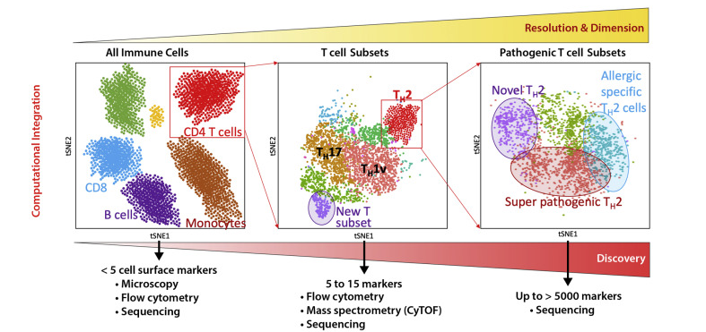
Biology to your data!
Annotating cells in single-cell gene expression data is a challenge!
-What’s a cell type?
Gene expression is not discrete but mostly a continuum
Gene expression ≠ cellular function
-Resolution
Subsets
Phenotypes
Differentiation
Seumois G, Vijayanand P 2019 . J Allergy Clin Immunol.

Slide 64
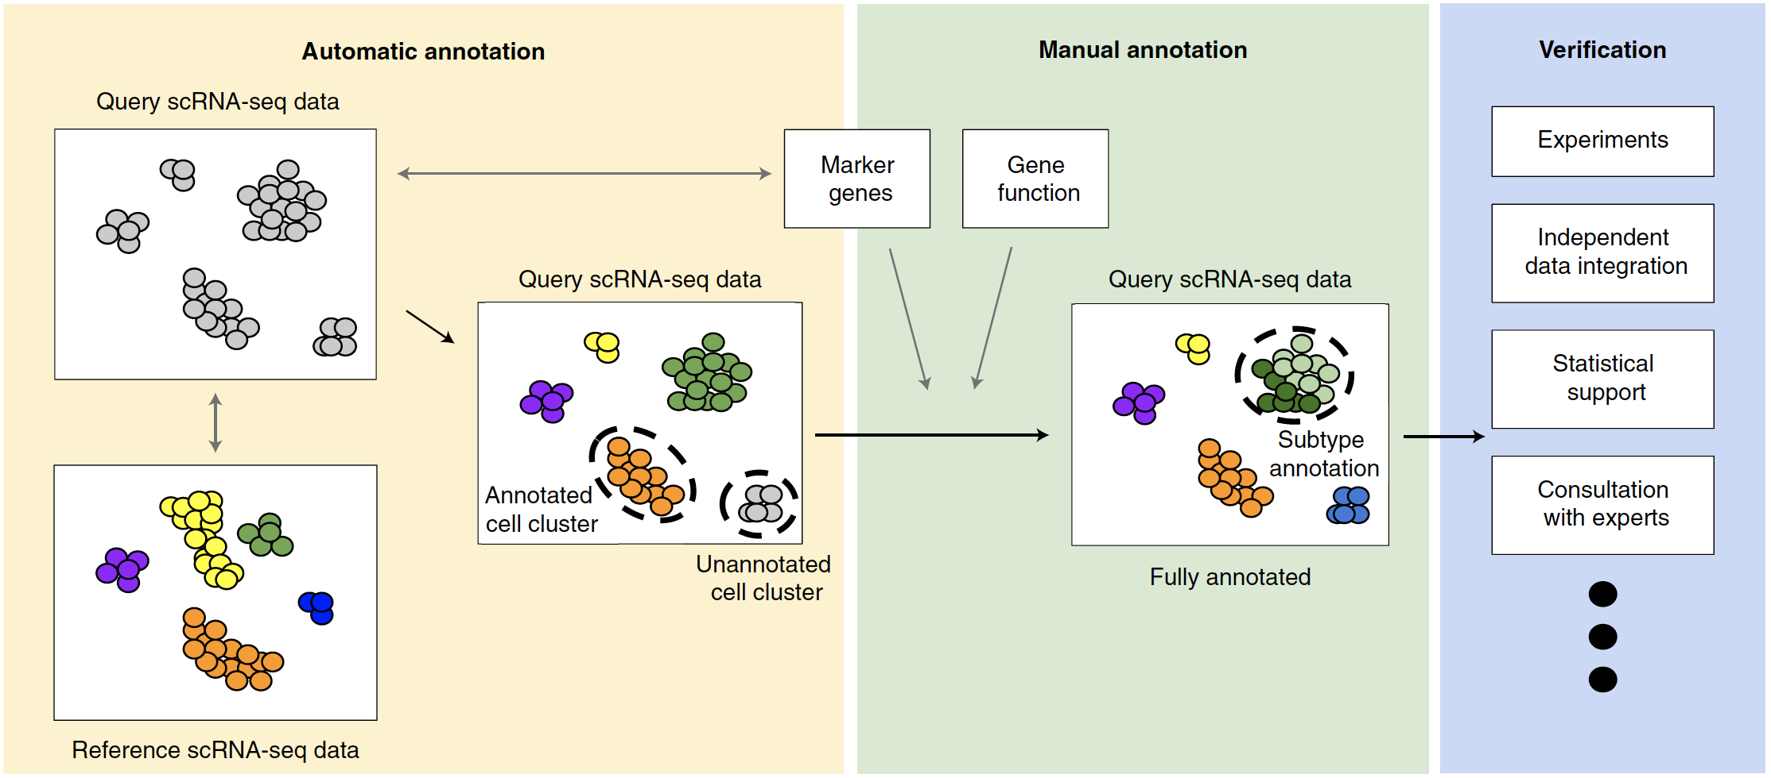
How to identify the cell types of clustered cells?
Clarke, Z. A. at al. (2021) Nature Protocols. 16: 2749-2764.
Abdelaal, T. et al., (2019) Genome Biology. 20:194.

Slide 65
Approach 1: De novo cluster annotation
Three main approaches to assigning clusters
Annotating based on known marker genes
Annotating on differential gene expression
Annotating on previously reported module scoring
Edge cases
Doublets
Low-quality cells
Host-pathogen annotations
Clustering accuracy
Over-clustering
Under-clustering
Iterative clustering

Slide 66
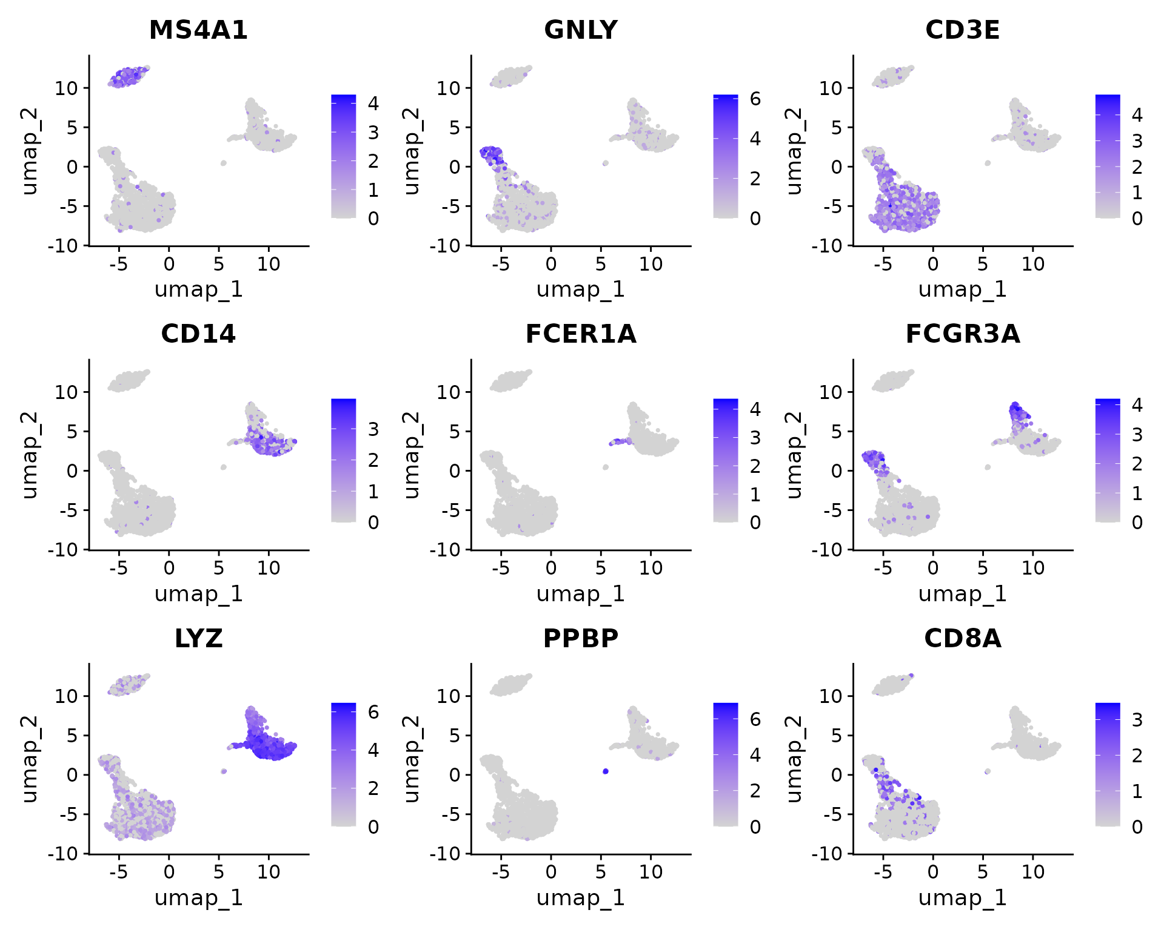
Annotating based on known marker genes
Requires understanding of expected cell types and their markers
Biological expertise here is critical
Many protein and RNA markers overlap
However, not all protein markers translate well into RNA space
Experience with cell types in sample and scRNA-seq will help identify which protein markers do or do not translate to RNA space
Useful for identifying coarse cell types and states, but difficult to identify novel cell states in disease
Source: Seurat documentation

Slide 67
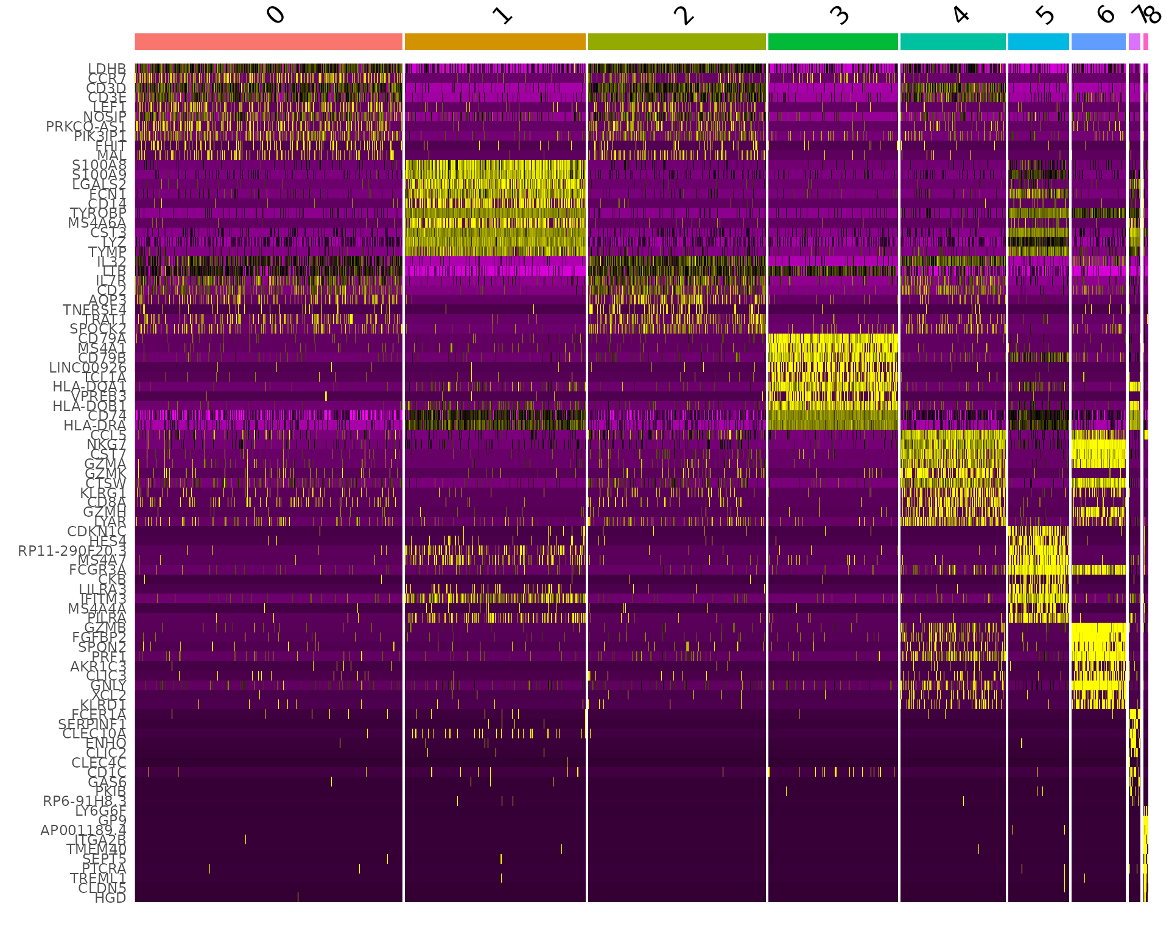
Annotating on differential gene expression
Begin with one-against-all differential expression test
Known marker genes that are highly expressed should show up
Top 20 to 30 genes should give an indication of the cell states as well as cell type
Easier to annotate based on upregulated rather than downregulated genes
Ex. Inflammatory, anti-viral, low-quality, etc.
There will likely be clusters that are very similar to each other
Run differential gene expression between those similar clusters ONLY to figure out what’s different between them
If differential gene expression doesn’t make sense biologically, combine clusters into one
This is an iterative process
You should not expect to be able to confidently identify all your cell clusters on your first pass
Source: Seurat documentation

Slide 68
Annotating on previously reported module scoring
Supplementary tables will usually list differential gene expression used for assigning clusters in other studies
Use these to your advantage
Great for checking work
Make sure species and system are correct
Technology used may influence results
These basic techniques should not be used in a vacuum—they build on each other to convince you that you have annotated your clusters correctly

Slide 69
Approach 2: Databases and Reference atlases
Marker genes and databases
Literature
Tissue and protein DB
Single-cell atlases
Automated tools
Correlation-based
Supervised classification

Slide 70


Approach 2: Marker genes and databases
Literature!
Single-cell RNAseq is a new field but cell types are not!
Book knowledge is important, know your model!
Rely on experts and collaborators

Slide 71

Approach 2: Marker genes and databases
Human tissue and protein DB
Protein cell atlas
https://www.proteinatlas.org/
Immunological Genome Project
https://www.immgen.org/
GTEx (Genotype-Tissue Expression)
https://gtexportal.org/home/

Slide 72
Approach 2: Marker genes and databases
Other organism
Mouse https://www.emouseatlas.org
Fly https://flybase.org/
C. elegans https://www.wormatlas.org/
Zebra fish https://bio-atlas.psu.edu/zf/
NCBI
https://www.ncbi.nlm.nih.gov/
The European Bioinformatics Institute (EMBL- EBI)
https://www.ebi.ac.uk/services

Slide 73
Approach 2: Single-cell atlases
Single-cell DB for manual annotation
Meaning you have your set of genes and search for them one by one in these DB
Human cell atlas (HCA) https://www.ebi.ac.uk/humancellatlas/project-catalogue/
Tabula muris (Mouse atlas)
Broad institute Single-cell portal https://singlecell.broadinstitute.org/
PanglaoDB https://panglaodb.se/
CellMarker http://biocc.hrbmu.edu.cn/CellMarker/index.jsp

Slide 74


Approach 2: Single-cell atlases
Single-cell DB for manual annotation
Human Cell Atlas https://data.humancellatlas.org/

Slide 75
Approach 2: Single-cell atlases
Single-cell DB for manual annotation
PanglaoDB https://panglaodb.se/

Slide 76

Approach 2: Automated tools
Project cells or clusters from a new sample onto a reference (Cell Atlas or previous study) to identify cells with novel/unknown identity ----> Cell type like BLAST method
IMPORTANT: A reference cell type information is needed
Can be done intra-species
Different-omics!
Different approaches
Correlation-based
Supervised classification
https://www.singlecellcourse.org/

Slide 77
Approach 2: Automated tools
Approach | Tool name | Language | Computational approach
Correlation-based | scmap-cluster | R, web app | Cosine, Spearman, Pearson
 | scmap-cell | R, web app | Cosine distance based kNN
 | SingleR | R | Spearman
 | CHETAH | R, Shiny app | Spearman + confidence
 | scMatch | Python | Spearman, Pearson
 | ClustifyR | R | Spearman, Pearson, Kendall, cosine
 | CIPR | R, Shiny app | Dot product, Spearman, Pearson
Supervised classification-based | CaSTLe | R | XGBoost classifier
 | Moana | Python | kNN-smoothing + SVM
 | LAmbDA | Python | Multiple ML techniques
 | superCT | Web app | Artificial Neural Network
 | SingleCellNet | R | Random Forest
 | Garnett | R | Elastic net regression
 | scPred | R | SVM
 | ACTINN | Python | Artificial Neural Network
 | OnClass | Python | kNN and Bilinear Neural Network
 | scClassify | R, Shiny app | Weighted kNN classifier
 | scArches | Python | Autoencoder
Pasquini et al, 2021, Computational and Structural Biotechnology Journal

Slide 78


Approach 2: Automated tools
The search can be done by cluster or by cell , in each cluster/cell by its centroid (a vector of the median value of the expression of each gene) and measure the similarity between c and each cluster centroid or cell in the refence is calculated and ranked
Pasquini et al, 2021, Computational and Structural Biotechnology Journal

Slide 79

Recent helpful articles on data integration methods
An ideal cluster/cell type annotation process is composed of three major steps: automatic cell annotation, manual cell annotation and verification
Clarke, Z.A., Andrews, T.S., Atif, J. et al Nat Protoc 16, 2749–2764 (2021).

Slide 80

Example
366.650 cells from human colon mucosa

Slide 81


Example
Unsupervised clustering
Projected annotation from Smillie et al 2019
scMAP

Slide 82

Example: validate with markers
B.

Slide 83
Example: validate with markers
B.

Slide 84
Example: annotate clusters

Slide 85
Example: annotate clusters

Slide 86
Example: annotate clusters

Slide 87
Suggested reading
Reviews:
Luecken M. D. et al. Molecular Systems Biology (2019) 15:e8746.
Kiselev C. et al. (2019) Nature Reviews Genetics. 20: 273-282.
Tutorials:
https://satijalab.org/seurat/articles/pbmc3k_tutorial
https://scanpy.readthedocs.io/en/stable/tutorials/basics/clustering.html
Software:
Single-cell analysis in R:
Seurat: https://satijalab.org/seurat/
Single-cell analysis in python:
Scverse: https://scverse.org/
scanpy: https://scanpy.readthedocs.io/en/stable/

Slide 88



Read broadly, read deeply
Other single-cell papers: Fun analyses to use as starting points for extensions to your own work!
Statistics (from introductory to advanced):
Introduction to Statistical Learning
Statistical Rethinking
Causal Inference (Judea Pearl)
Immunology (from introductory to advanced):
How the Immune System Works
Janeway’s Immunology
Biophysical principles:
Physical Biology of the Cell

Slide 89


Aesthetically-pleasing figures: color palettes!
Coolors.co
https://medialab.github.io/iwanthue/
Instagram movie palette pages

